Slide 1
INTRODUCING LEAST SQUARES ADJUSTMENT TECHNIQUES FOR SURVEYING AND GEODESY
Joel van Cranenbroeck, Managing Director CGEOS
CREATIVE GEOSENSING SPRL-S
Rue du Tienne de Mont, 11
BE-5530 MONT – Belgium joel@creative-geosensing.com

Slide 2
« One measure is not a measure »
Good practice in surveying leads to perform more measurements than necessary ! Those extra measurements help to provide effective control on the results.
Distance measurements back and forward (traverse network)
Measuring the 3 angles of a triangle ( the sum must be 180 degrees)
Levelling loops (the sum must be zero)
Left and right side telescope measurements (to check the effect of small misalignments of mechanical components of a Total Station into the measurements)
Those “extra” measurements aim to :
Detect outliers in the observations (gross errors)
Check other measurements.
Provide consolidated results (best estimate)
Judge of QUALITY = Precision + Reliability

Slide 3
From multiple measurements to an unique result (best linear unbiased estimator)
 | Serie 1 | Serie 2
1 | 1.456 | 1.456
2 | 1.567 | 1.457
3 | 1.345 | 1.453
4 | 1.678 | 1.453
5 | 1.453 | 1.467
6 | 1.456 | 1.459
7 | 1.467 | 1.453
8 | 1.678 | 1.452
9 | 1.567 | 1.459
 | Serie 1 | Serie 2
1 | 1.456 | 1.456
2 | 1.567 | 1.457
3 | 1.345 | 1.453
4 | 1.678 | 1.453
5 | 1.453 | 1.467
6 | 1.456 | 1.459
7 | 1.467 | 1.453
8 | 1.678 | 1.452
9 | 1.567 | 1.459
MEAN | 1.519 | 1.457
STDEV | 0.112 | 0.005
MEDIAN | 1.467 | 1.456
MIN | 1.345 | 1.452
MAX | 1.678 | 1.467
Δ Min-Max | 0.333 | 0.015
What series has the more “precise” measurement ?
How will you consider a new 10th measurement ? What will be your criteria to accept or deny ?

Slide 4
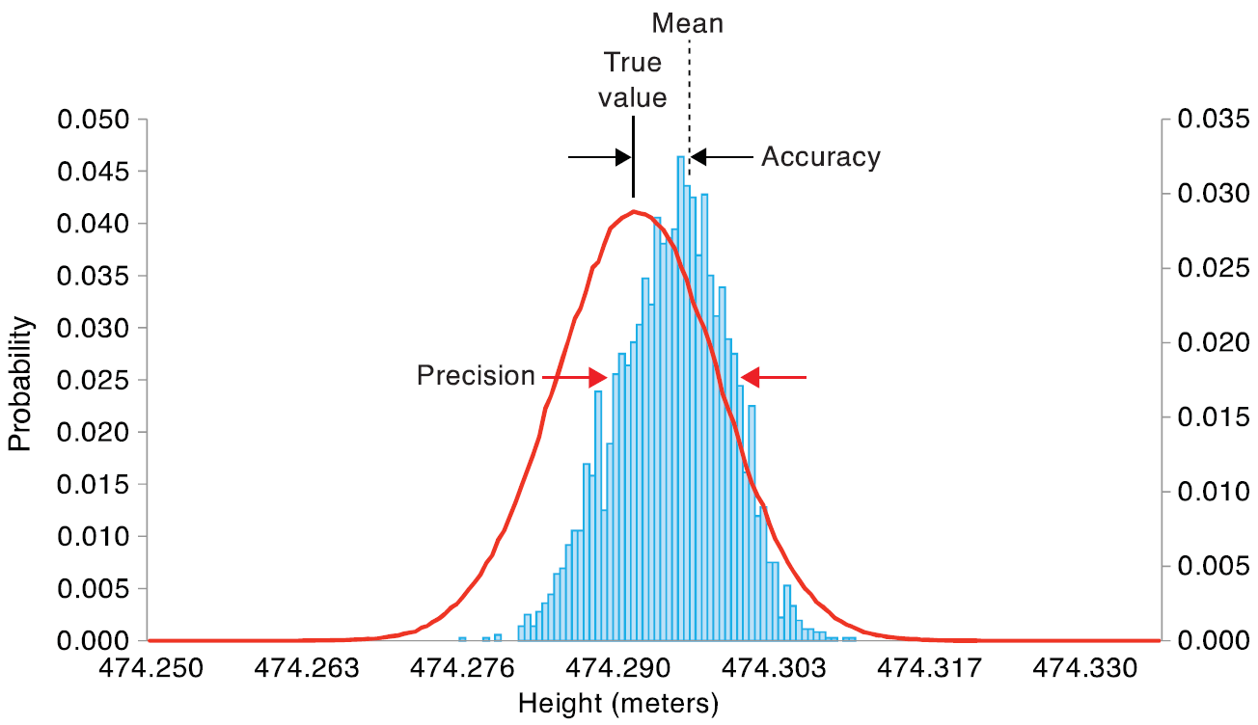
Design, Quality Control and Analysis of Surveying Measurements …
Statistical inference is essential to get a better understanding into the survey measurements. Statistic and Probability are as older as geodesy and surveying.
More and more even, statistical analysis is the only way to provide results such for GNSS where Least Squares Adjustment is playing a fundamental role to achieve high accuracte performances.

Slide 5
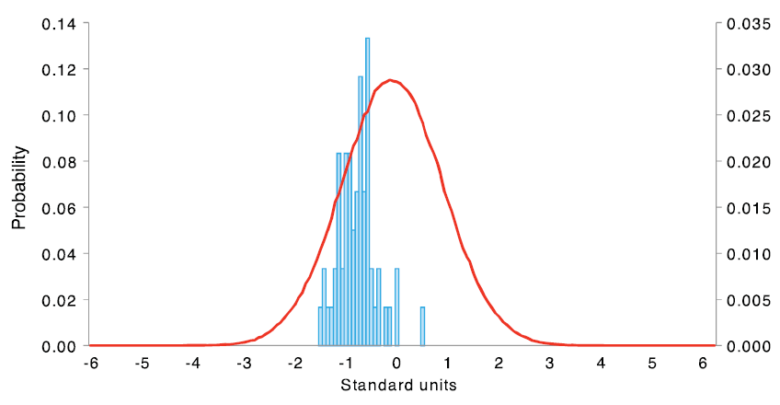
True Value, Precision and Accuracy … Frequency distribution of 1 min. GPS data

Slide 6
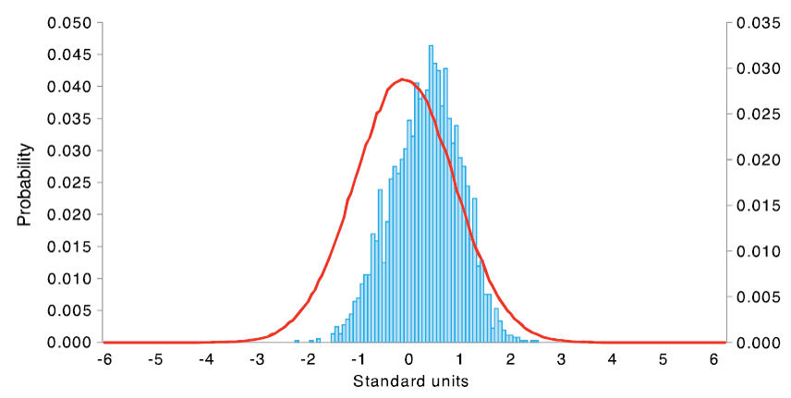
True Value, Precision and Accuracy … Frequency distribution of 1 hour GPS data

Slide 7
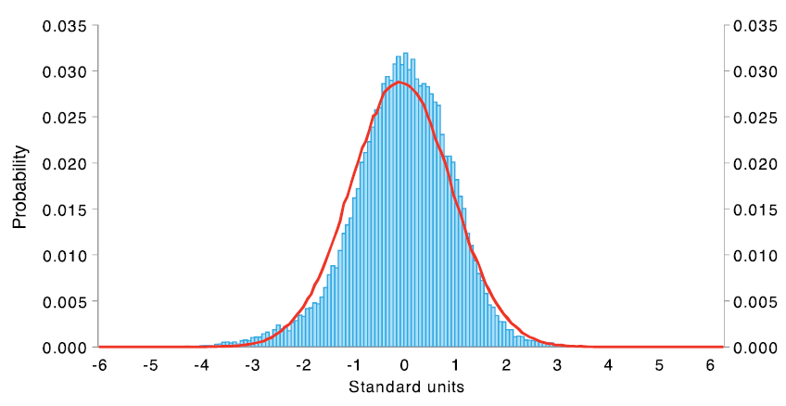
True Value, Precision and Accuracy … Frequency distribution of 12 hours of GPS data

Slide 8
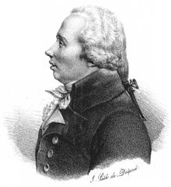
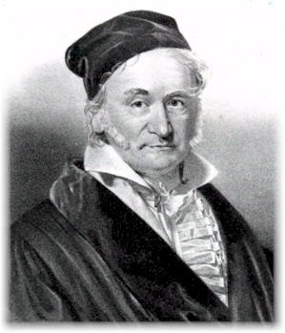
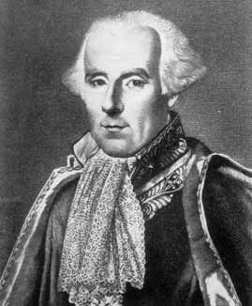
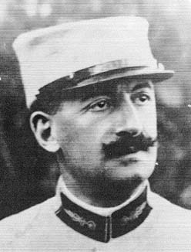
From multiple measurements to an unique result (best linear unbiased estimator)
LEGENDRE invented the Least Squares Adjustment Method for determining the planet’s orbits.
GAUSS provided the mathematical basis and rigorous formulation.
LAPLACE, TCHEBYCHEV et MARKOV contributed with much developments.
The geodesists DOOLITTLE, HELMERT, TIENSTRA, MEISSL et MORITZ performed important work to apply that method in geodesy.
CHOLESKY, BANACHIEWICZ, GAUSS et JORDAN invented algorithms to solve challenges especially in numerical analysis (linear equations).

Slide 9
Let’s start with a levelling network
We want to determine the altitude (orthometric height) of B and C knowing the altitude of A and using levelling technique :
HA = 124.180 m.
Observations :
dh1 = + 6.14
dh2 = + 8.34
dh3 = - 14.48
dh4 = - 8.35
dh5 = - 6.16

Slide 10
Observation Equation Functional (Mathematical) Model
We can write for each observation an equation which describe the relationship between the point’s altitude :
HA + dh1 = HB
HB + dh2 = HC
HC + dh3 = HA
HC + dh4 = HB
HB + dh5 = HA

Slide 11
Observation Equation Functional (Mathematical) Model
The « unknowns » are written at the left hand side and we introduce the corrections (also named residuals) «vi » :
HB = HA + dh1 + v1
HB - HC = -dh2 + v2
HC = HA - dh3 + v3
HC - HB = -dh4 + v4
HB = HA - dh5 + v5

Slide 12
Observation Equation Functional (Mathematical) Model
In matrix notation, we can write the functional model :
Design matrix
Observations
Residuals/Corrections
Unknown/parameters

Slide 13
Observation Equation Functional (Mathematical) Model
or :

Slide 14
Observation Equation Functional (Mathematical) Model
We obtain an « over-determined » linear equation system ( n > m ) :
« n » observation equations, here n = 5
« m » unknowns/parameters ( the orthometric height of B and C ), here m = 2
To obtain a solution we must impose a « condition » on the corrections.
To minimalise the sum of the squared residuals is the « Least Squares Adjustment Principle » named Minimum Norm L2 … but we can also minimalise the sum of the absolute value of the residuals which is the basis of a « Robust » adjustment based on the Minimum Norm L1
L1 norm
L2 norm

Slide 15
Least Squares Adjustment Solution
The solution is obtained by applying the Least Squares principles on the functional model that can be written in matrix notations such :
The squared corrections (Least Squares) is obtained :

Slide 16
Least Squares Adjustment Solution
Let’s start developping :

Slide 17
Least Squares Adjustment Solution
We obtain easily :
And as :
First derivative :

Slide 18
Least Squares Adjustment Solution
To « minimise » that result, one need to set the first derivative to zero, then :
We get the following solution :
Assuming that is positive definite !

Slide 19
Back to the levelling network …
The Normal Matrix N and its inverse :

Slide 20
Back to the levelling network …
The solution is given by :

Slide 21
Adjusted observations and corrections …
The adjusted observations are obtained by :
The corrections by :

Slide 22
The Adjustment’s results for B and C
B = 130.326 m.
C = 138.667 m.
A = 124.180 m.
Corrections :
v1 = + 0.006
v2 = + 0.001
v3 = - 0.007
v4 = + 0.009
v5 = + 0.014

Slide 23
What is the difference between those networks ?

Slide 24
The Stochastical Model …
The idea is to integrate the information about the accuracy of the measurements - a priori.
One can speak about an entire definite stochastical model by the standard deviation of the observations estimated a priori.
That means we have to take into account all the factors … and not only the manufacturer specification !
For a Hz direction for instance :
The standard deviation of the Hz measurement
The centrering error of the instrument
The centrering error of the target
etc.
The variance-covariance matrix of the observations is built with all that information …

Slide 25
The Stochastical Model …
That matrix is defined by the cofactor matrix and the variance factor. That is the variance factor of the weight unit …

Slide 26
The Stochastical Model …
The inverse matrix of the variance-covariance matrix is named « weight matrix ».
The function to minimize becomes :
With the solution :

Slide 27
The « a posteriori » quality indicators are defined …
Those are the variance-covraiance matrices scaled by the variance factor « a posteriori ».
Variance factor :
variance-covariance matrix of the parameters :
variance-covariance matrix of the adjusted observations :
Matrice variance-covariance des corrections :

Slide 28
Back to the levelling network …
Estimation of the variance factor « a posteriori » often named empirical variance factor :
Remember we selected the a priori variance factor to 1 cm !

Slide 29
Back to the levelling network …
Variance-covariance matrix of the parameters :
The standard deviation of the parameters are :

Slide 30
Quality of the results … still some questions …
Now we have all the information that is needed to « judge » of the quality results …
What if we had choosen another point then A ?
Is it necessary to fix a point ?

Slide 31
Back to the levelling network …
Variance-covariance matrix of the observations :

Slide 32
Back to the levelling network …
Variance-covariance matrix of the observations :

Slide 33
Back to the levelling network …
Variance-covariance matrix of the corrections :

Slide 34
Redundancy, degree of freedom …
The degree of freedom « r » is defined as the difference between the number of observation and the number of parameter :
The trace of the matrix is egal to the degree of freedom « r » :

Slide 35
Redundancy, degree of freedom …
Each diagonal element of that matrix is expressing an important information about how each observation is contributing the the total redundancy of the system …
We consider the following criteria :
not controlled observation
badly controlled observation
controlled observation
well controlled observation

Slide 36
Back to the levelling network …
Local redundancy factor « r » :
r1 = 0.625
r2 = 0.625
r3 = 0.500
r4 = 0.625
r5 = 0.625
We have pretty well controlled observations …

Slide 37
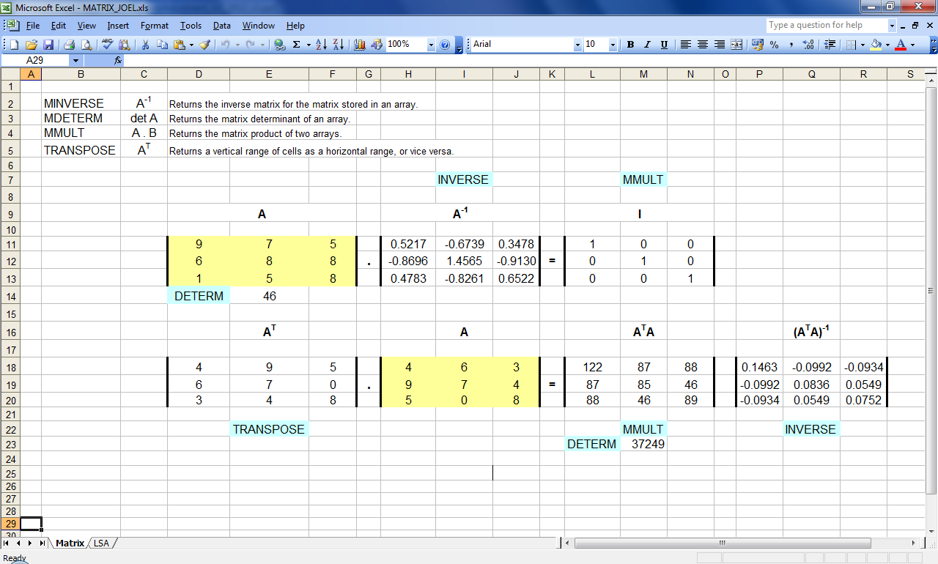
MS Excell provides Matrix operators!

Slide 38
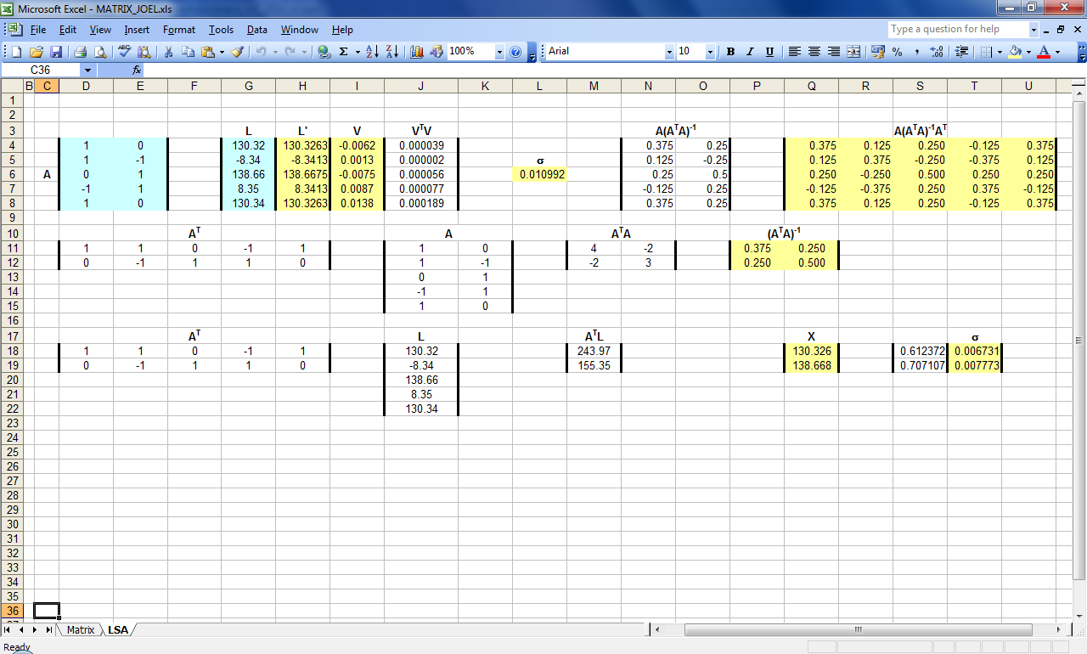
MS Excell provides Matrix operators !

Slide 39
From a Levelling Network up to GPS Network … The functional models are similar …
A = R + b1
B = R + b2
C = R + b3
D = R + b4
B - F = b5
C – F = b6
D - F = b7
E - F = b8
A - D = b9
B - D = b10
C - D = b11
E - D = b12
R
b1
A
b2
b3
B
b4
b9
b10
D
b11
C
b5
b6
b12
b7
F
E
b8

Slide 40
From a Levelling Network up to GPS Network … The functional models are similar …
R
b1
A
b2
B
b3
b4
b9
b10
D
b11
C
b5
b6
b12
b7
F
E
b8

Slide 41
How to model a simple Levelling line ?
Setup the equations for each observation
Build the functional model and derive the Least Squares Adjustment solution without considering any observation (simulation).
What would be the “reliability” ?
R
Δ1
A
B
C
Δ2
Δ3
Δ4
D
Δ5
E
F
Δ6

Slide 42
How to model a simple Levelling line ?
Setup the equations for each observation
Build the functional model and derive the Least Squares Adjustment solution without considering any observation (simulation).
What would be the “reliability” ?
R
Δ1
A
B
C
Δ2
Δ3
Δ4
D
Δ5
E
F
Δ6

Slide 43
In geodesy and surveying we have also directions ( H_{z} , V_{z} ) and distances …
Like for the levelling network we have to write the “functions” to setup the equations …
But the Least Squares Adjustment method is dealing with linear equations (non linear Least Squares is dealing with non linear functions but it’s out of our scope)
So with have to “linearized” the functions we are using by applying a decomposition in series of Taylor limited to the first order (because that’s the linear part…) around an approximated value.

Slide 44
Slope Distance :

Slide 45
Horizontal Distance :

Slide 46
Direction H_{Z} :
Gl₀
l₀
B
l_{AB}
A

Slide 47
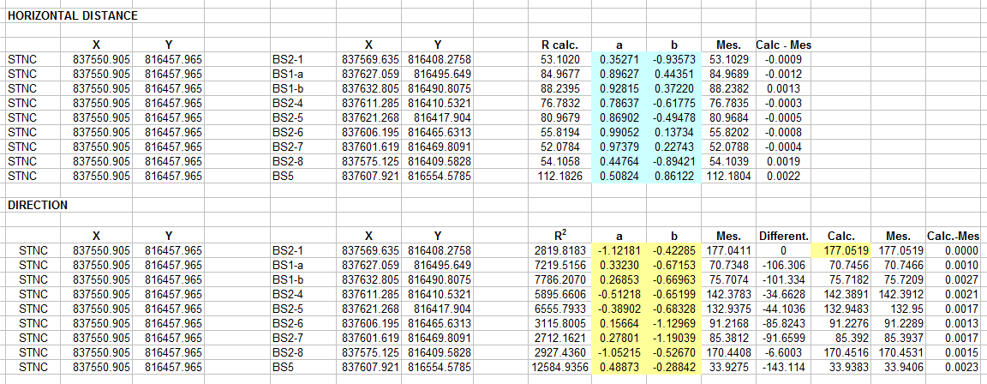
Computation of the coefficients a and b

Slide 48
Least Squares Adjustment
We find exactly the same adjusted coordinates than with Leica GeoMoS !

Slide 49
How about a Traverse ?
S
R
A
B
C
F

Slide 50
dg_{A} dx_{A} dy_{A} dg_{B} dx_{B} dy_{B} dg_{C} dx_{C} dy_{C}
R
A
B
C

Slide 51
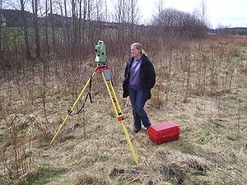
The case of the Free Station …
The principle of the “Free Station” method is to measure from a station point where we don’t have the coordinates, nor the orientation of the horizontal axis, to points that are defined in coordinates ( can be in x,y and z or only in x and y or only in z ).
X,Y
X,Y,Z
X,Y,Z
X,Y,Z
Z

Slide 52
What functional model is appropriated ? How it will best express the “reality” ?
We can consider a 3D transformation if the compensator of the TM30 has been switched off leaving the measurements to refer to the mechanical and optical axis of the Total Station … (Joel)
We can consider to process the measurement in 2D + 1D … (Joel)
We can consider to integrate all the measurement in a 3D solution referring to the gravity line. (Leica GeoMoS)

Slide 53
We can consider a 3D transformation …
By using the measurement and the approximate (or setup with local axis) coordinates of the station and an approximate Hz orientation (or any direction) we are computing the “local” coordinate of all the “control” points.
Then we basically have to compute a 3D transformation from the “local” coordinates into the “control” points reference system.
3 translations along X, Y and Z axis
3 rotations along the X,Y and Z axis
1 scale factor

Slide 55
For 3 common points the following equations must be solved using Least Squares Adjustment …

Slide 56
[HONG KONG FREE STATION MEASUREMENTS]
STNC , 837550.905 , 816457.965 , 5.275
BS2-1, 837569.6435 , 816408.2781 , 8.5017
BS1-a, 837627.0530 , 816495.6637 , 14.9585
BS1-b, 837632.7967 , 816490.8244 , 12.2958
BS2-4, 837611.2951 , 816410.5442 , 8.9734
BS2-5, 837621.2760 , 816417.9176 , 8.9863
BS2-6, 837606.1948 , 816465.6419 , 8.8079
BS2-7, 837601.6167 , 816469.8191 , 8.8169
BS2-8, 837575.1333 , 816409.5892 , 8.0619
BS5 , 837607.8995 , 816554.5884 , 7.9920
[HONG KONG CONTROL POINTS]
BS2-1 , 837569.6347 , 816408.2758 , 8.5068 ,7
BS1-a , 837627.0590 , 816495.6490 , 14.9653 ,7
BS1-b , 837632.8048 , 816490.8075 , 12.3006 ,7
BS2-4 , 837611.2853 , 816410.5321 , 8.9787 ,7
BS2-5 , 837621.2677 , 816417.9040 , 8.9911 ,7
BS2-6 , 837606.1954 , 816465.6313 , 8.8144 ,7
BS2-7 , 837601.6187 , 816469.8091 , 8.8238 ,7
BS2-8 , 837575.1248 , 816409.5828 , 8.0678 ,7
BS5 , 837607.9205 , 816554.5785 , 7.9975 ,7

Slide 57
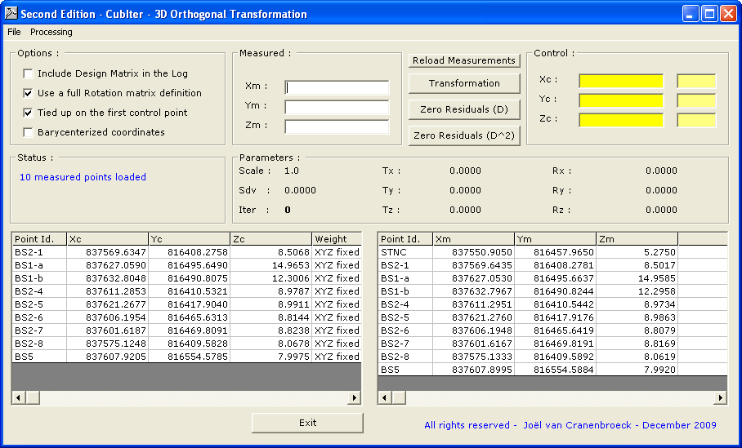

Slide 58
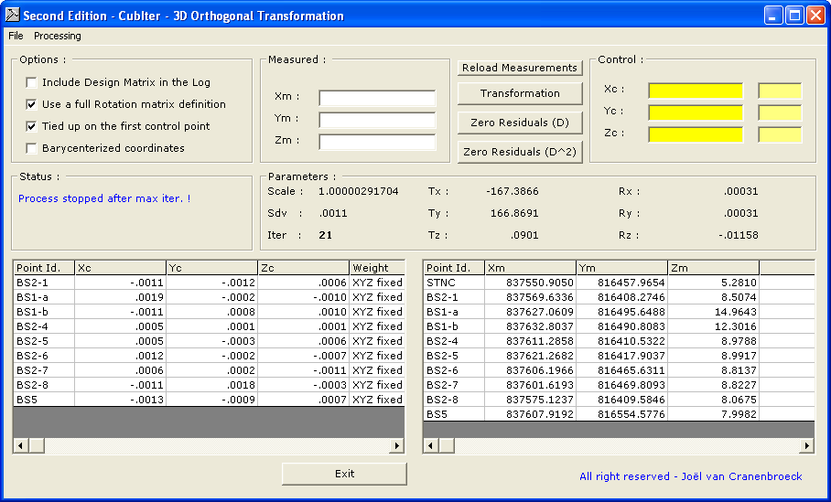

Slide 59
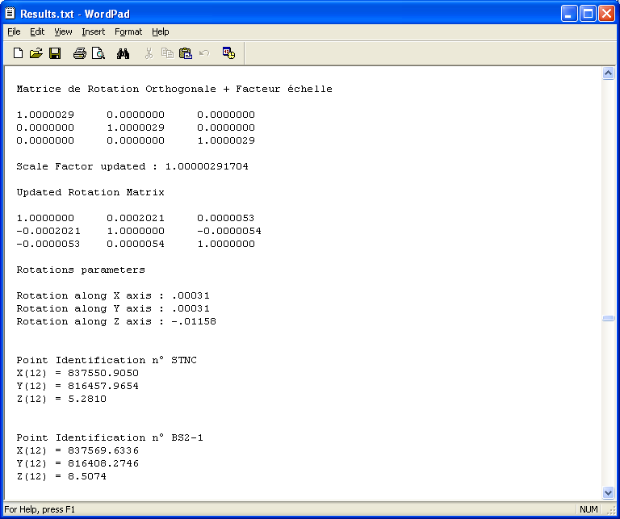

Slide 60
Corrections on Control Points :
Id. Vx(m) Vy(m) Vz(m)
BS2-1 -.0011 -.0012 .0006
BS1-a .0019 -.0002 -.0010
BS1-b -.0011 .0008 .0010
BS2-4 .0005 .0001 .0001
BS2-5 .0005 -.0003 .0006
BS2-6 .0012 -.0002 -.0007
BS2-7 .0006 .0002 -.0011
BS2-8 -.0011 .0018 -.0003
BS5 -.0013 -.0009 .0007
Tx updated : -167.3866
Ty updated : 166.8691
Tz updated : .0901
Scale Factor updated : 1.00000291704
Updated Rotation Matrix
1.0000000 0.0002021 0.0000053
-0.0002021 1.0000000 -0.0000054
-0.0000053 0.0000054 1.0000000
Rotations parameters
Rotation along X axis : .00031
Rotation along Y axis : .00031
Rotation along Z axis : -.01158
Point Identification n° STNC
X(20) = 837550.9050
Y(20) = 816457.9654
Z(20) = 5.2810
27.04.2012 00:07:12.960 Results of free station calculation (Reduced). Solution:ROBUST [GON/M]
27.04.2012 00:07:12.962 Station Coordinates: 837550.9051, 816457.9653, 5.2788
27.04.2012 00:07:12.964 Standard Deviations: 0.0006, 0.0005, 0.0003
27.04.2012 00:07:12.966 Orientation: 0.01264, 0.000285"
27.04.2012 00:07:12.967 Scale: 0.99999609, 0.00000735
STNC | X | Y | Z
LEICA | 837550.9051 | 816457.9653 | 5.2788
3D | 837550.9050 | 816457.9654 | 5.2810
Differences | 0.0001 | -0.0001 | -0.0022

Slide 61
Joel’s principle : every survey that handles directions and distances can be processed by using a 2D/3D transformation !
Free Station, Traverse, Radial Survey, … every type of survey where for each point the directions and distances are measured, can be processed using a 2D/3D transformation !
That flexibility doesn’t only simplify the processing but much more interesting, allows design that would never been imagined before …

Slide 62
Conclusion
It’s only a “taste” of what can de done with the LEAST SQUARES ADJUSTMENT TECHNIQUES
At least here you will find the correct equations and coefficients that will help you to develop your own applications
There are – of course – much to say and much more to learn !
Keep practicing !
Prof. Joël van Cranenbroeck

