Slide 1
MARS, N3, N5, T300 web interface (not the N2)
Prof. Joël & Nicolas van Cranenbroeck, Administrators
CGEOS® CREATIVE GEOSENSING Srl Belgium
CGEOS SPRL

Slide 2
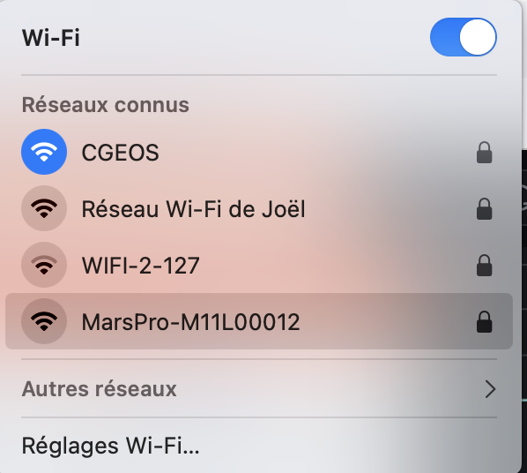
ComNav GNSS receivers WEB Interface
For the T300, T300PLUS, N3, N5, MARS, the user can benefit of the Wi-Fi Web Interface. Please note that N2 and VENUS Laser don’t have Wi-Fi then no Web Interface !
To connect the Web Interface, at first look at the WiFi hotspot list and selected the one of your receiver.
Of course, connecting to the Web Interface, you will not have access of Internet anymore from your PC
The password is : 12345678 and can be changed later using the web interface !

Slide 3
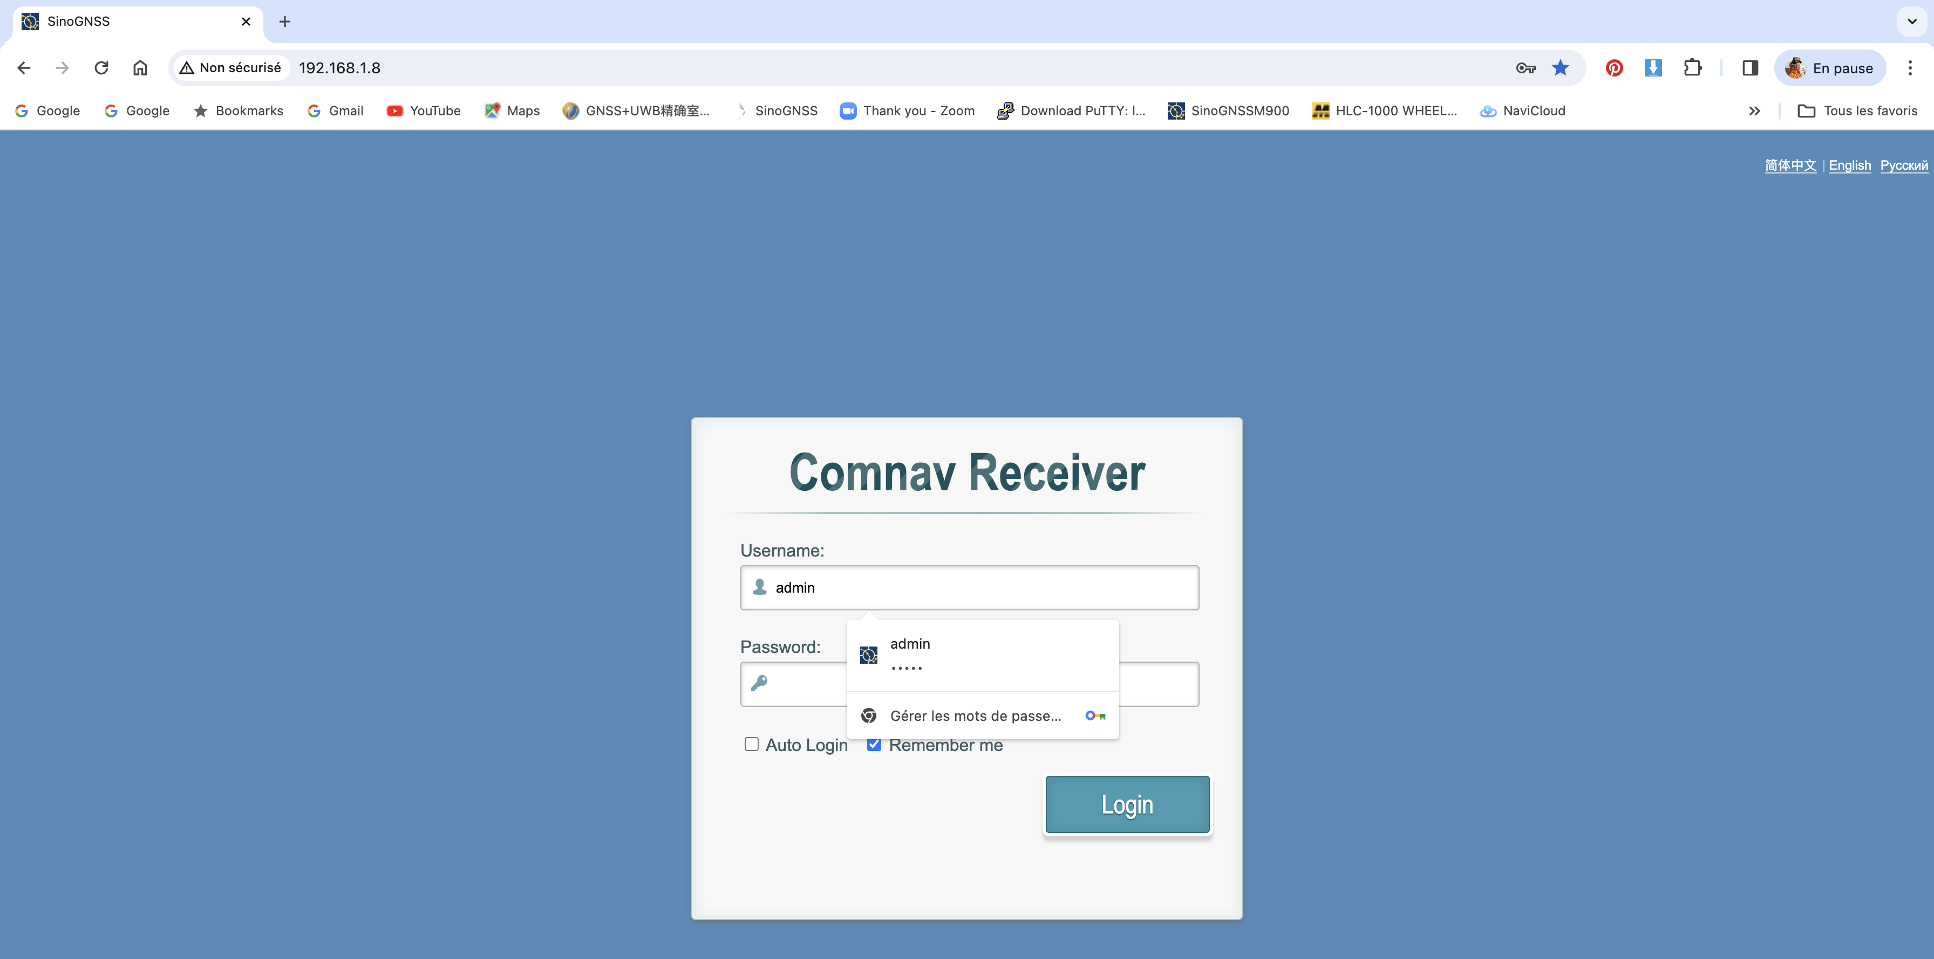
Using Chrome for instance, you have to type the following IP address : 192.168.1.8 and then you will get the launching page where the Username and Password are both “admin”. Select ENGLISH

Slide 4
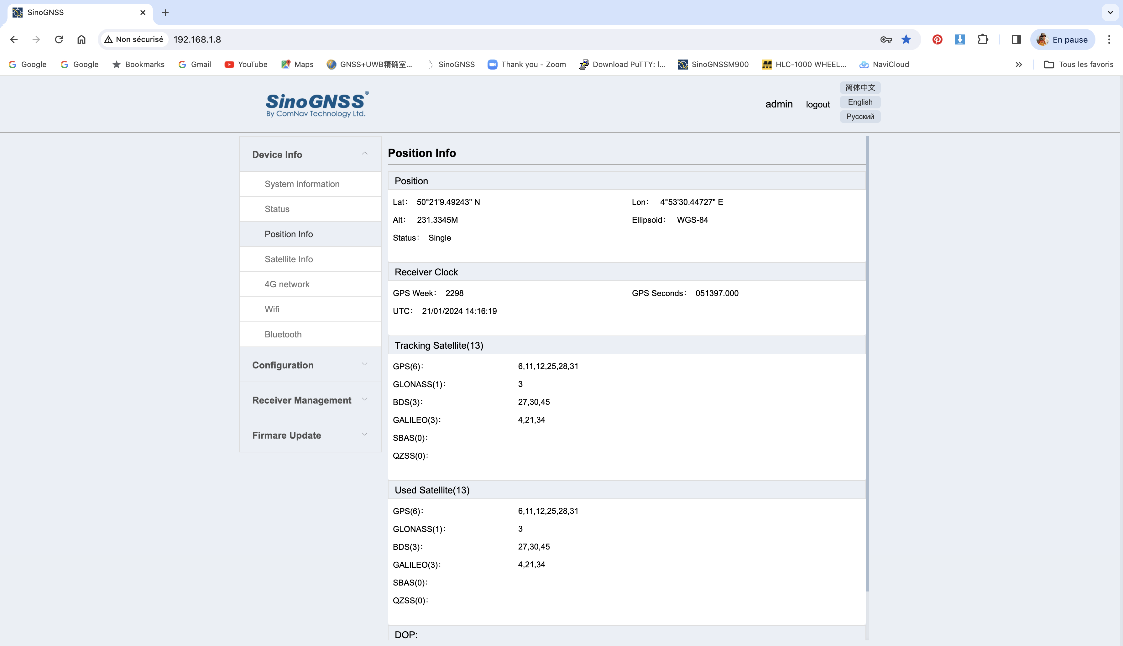
All commands are listed in the left hand side column such “Position Info”

Slide 5
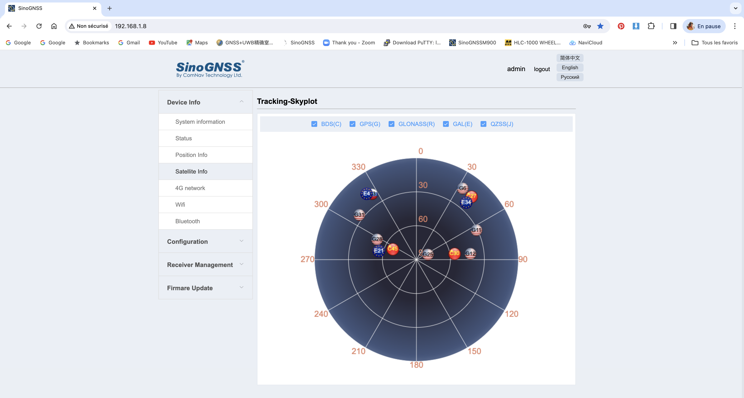
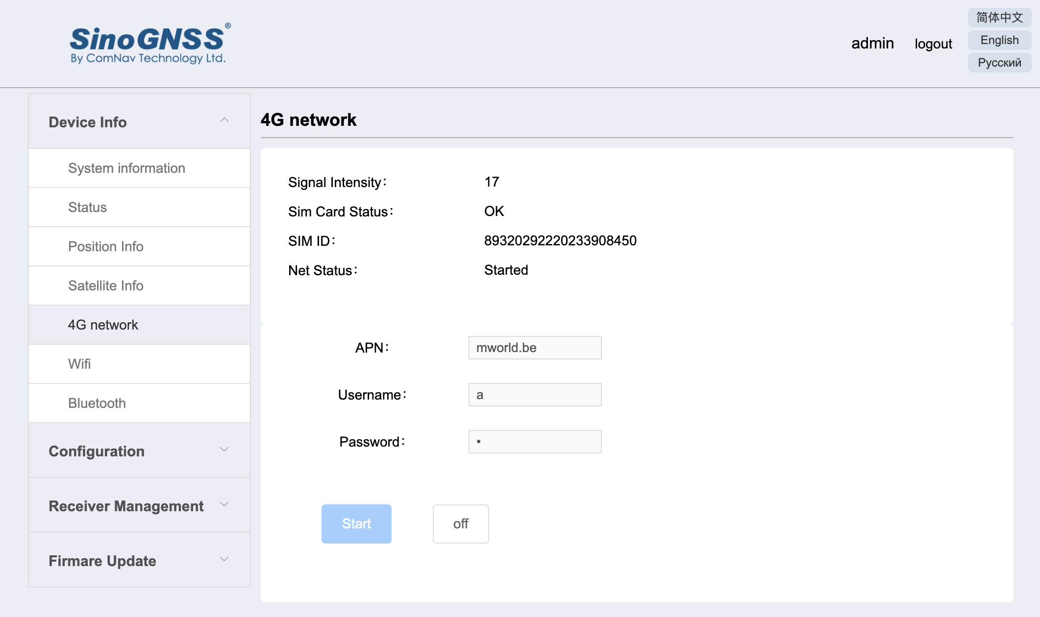
If you set a SIM Card on the receiver head, you can configure the NTRIP Client and therefore get RTK ! You can also stream the data to a TCP-IP server …
Please note that when you configure the receiver using SURVEY MASTER, the configuration will follow here with the Web Interface.
CGEOS SPRL

Slide 6
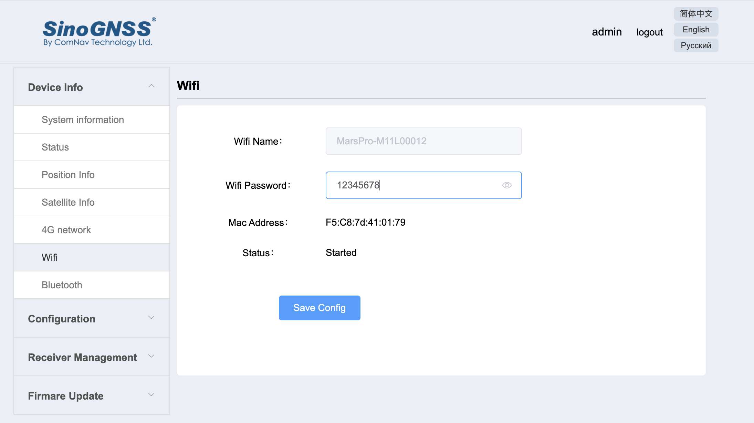
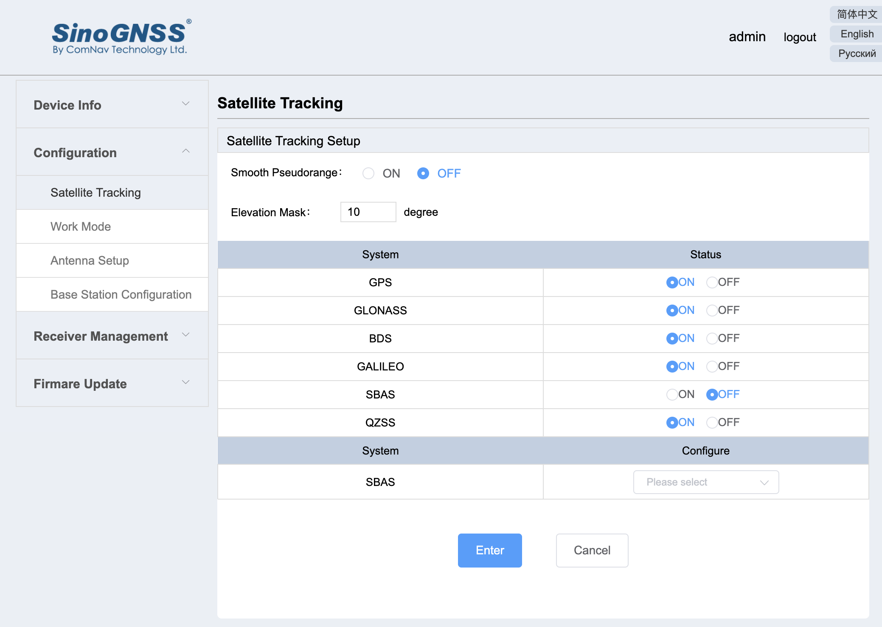
You can change the Wi-Fi password and instead of “12345678” put something more realistic as a password ! But when you change it , please keep it in mind !
You can configure the GNSS constellations and even the SBAS service

Slide 7
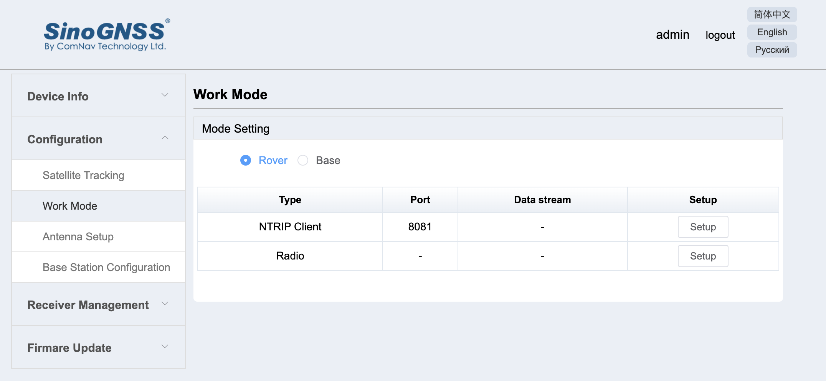
You can configure NTRIP Client assuming you have an unprotected SIM card in the receiver’s head ! (take the PIN out)
CGEOS SPRL

Slide 8
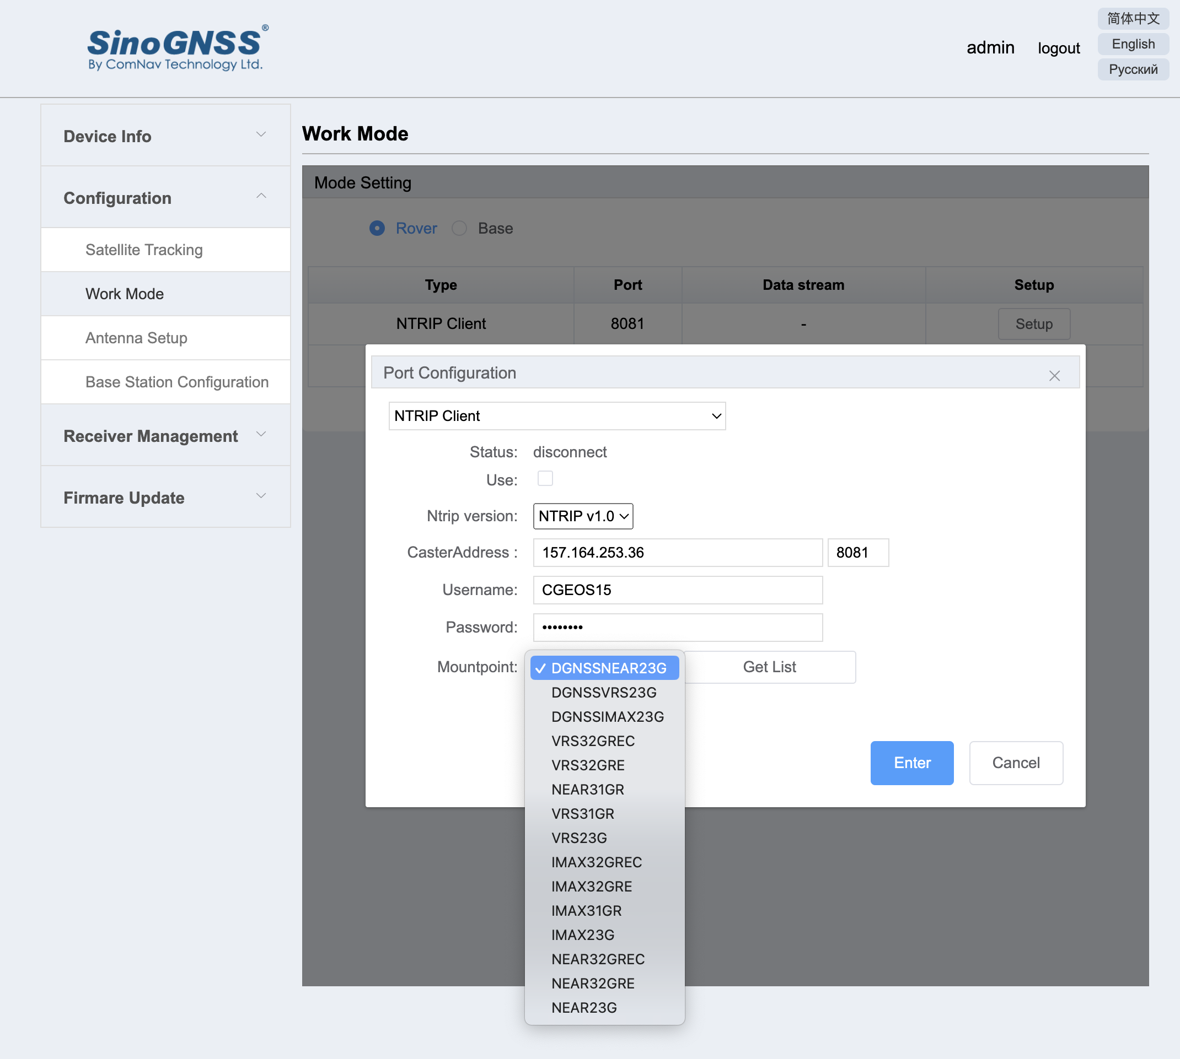
You have to add the Server IP here 157.164.253.36, the port, here 8081, your username and password and selected the mount point as here “VRS32GREC”
Then check the box USE !
CGEOS SPRL

Slide 9
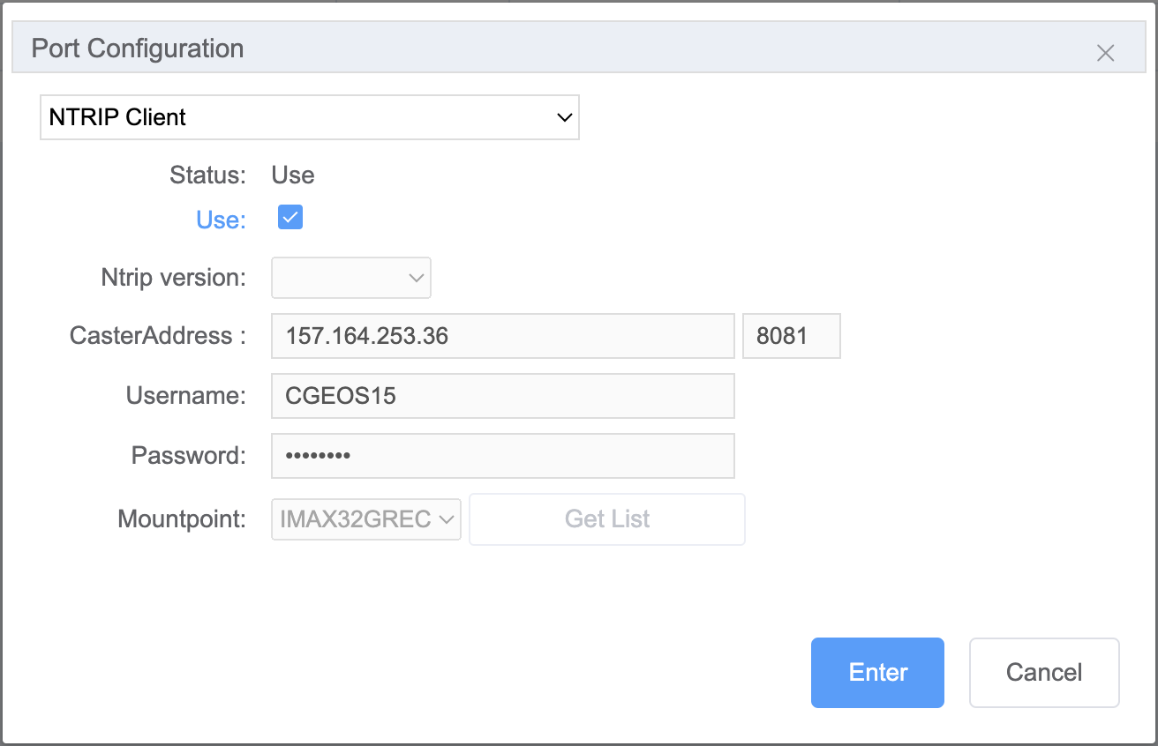
Then check the box USE !
CGEOS SPRL

Slide 10
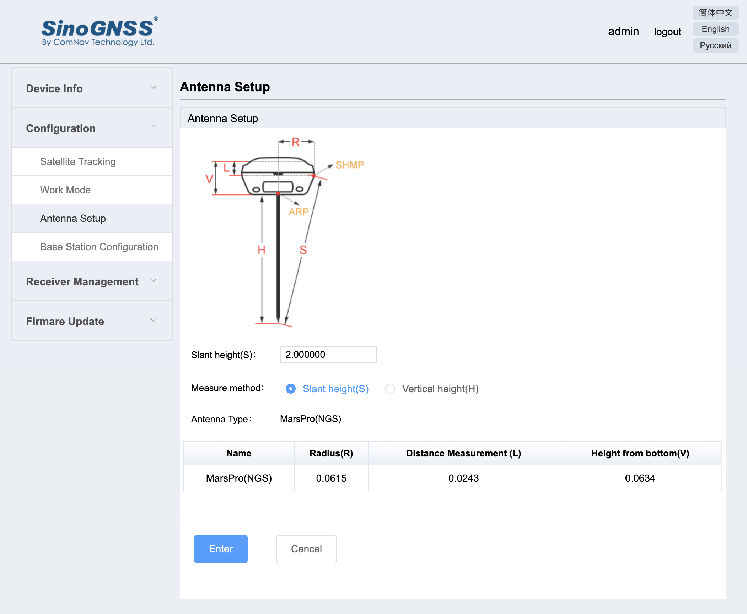
Configure the antenna …
CGEOS SPRL

Slide 11
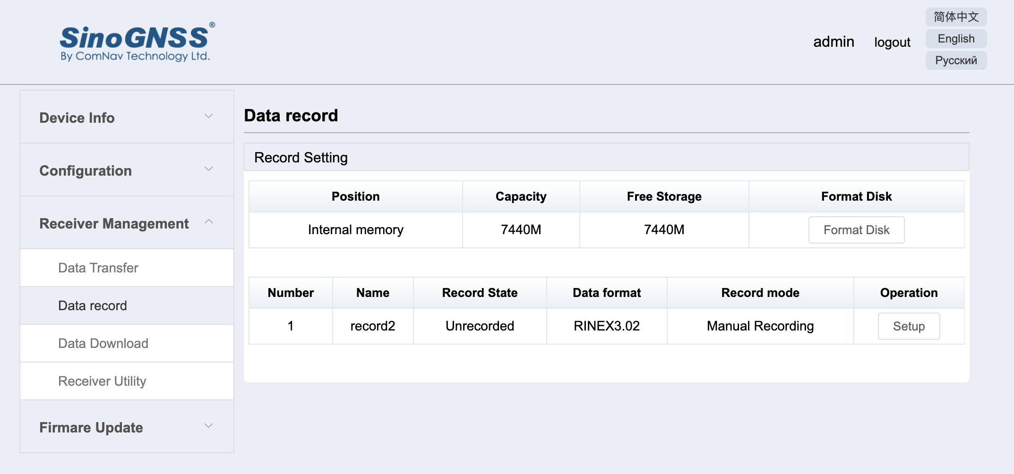
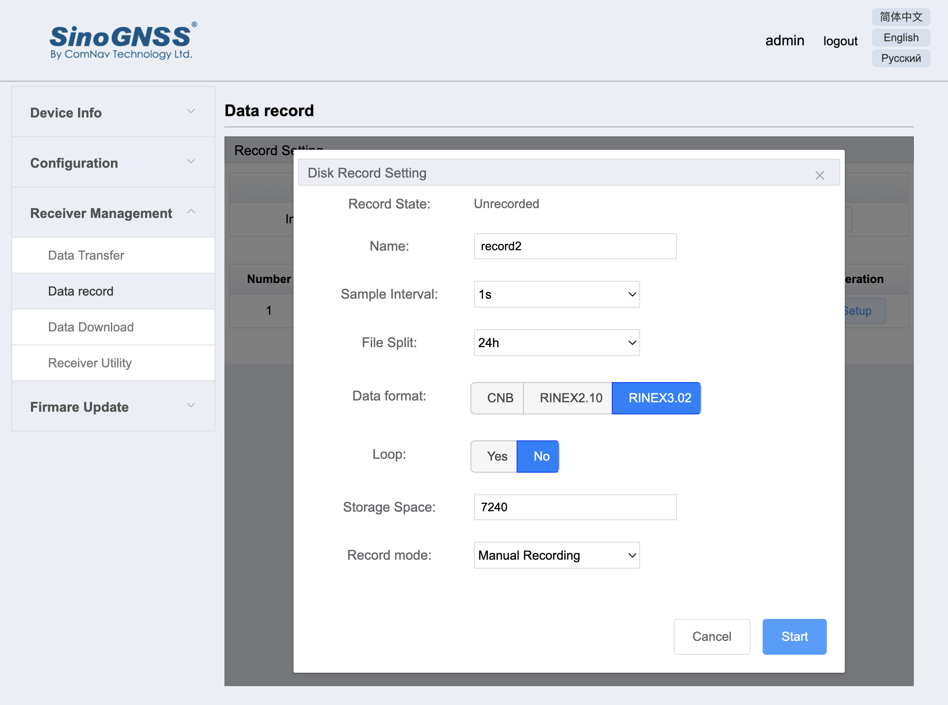
You can store RINEX data directly in the receiver memory !
Just press SETUP to configure !
Of course the receiver must track GNSS data … and when you setup (START), the receiver will beep and another led will start blinking …

Slide 12
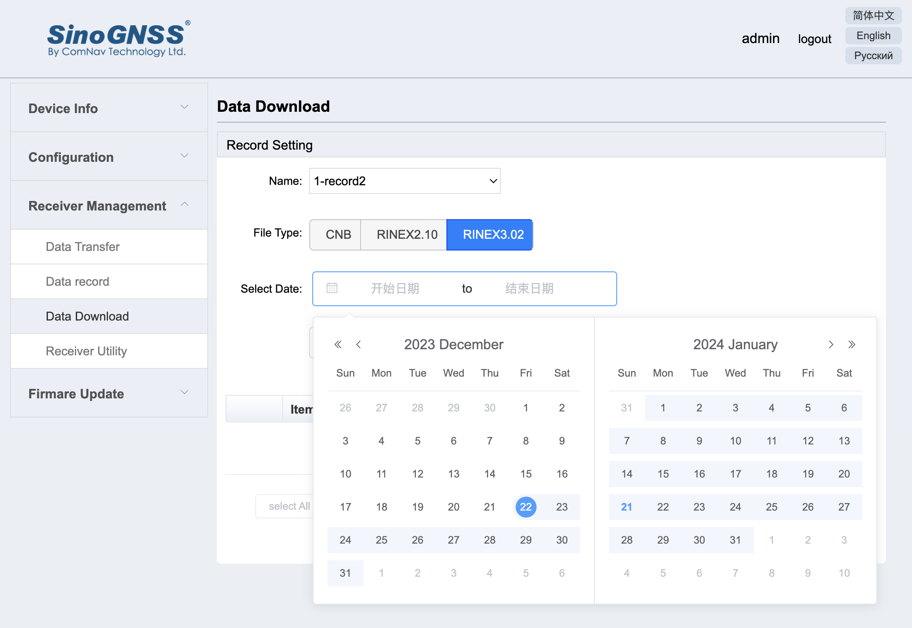
To download the data, select the format you have used (RINEX3.02) and then the start and end date.
It’s not easy to get it but you have to click on the calendar for START and on the calendar to END
Check the dates are ok !
CGEOS SPRL

Slide 13
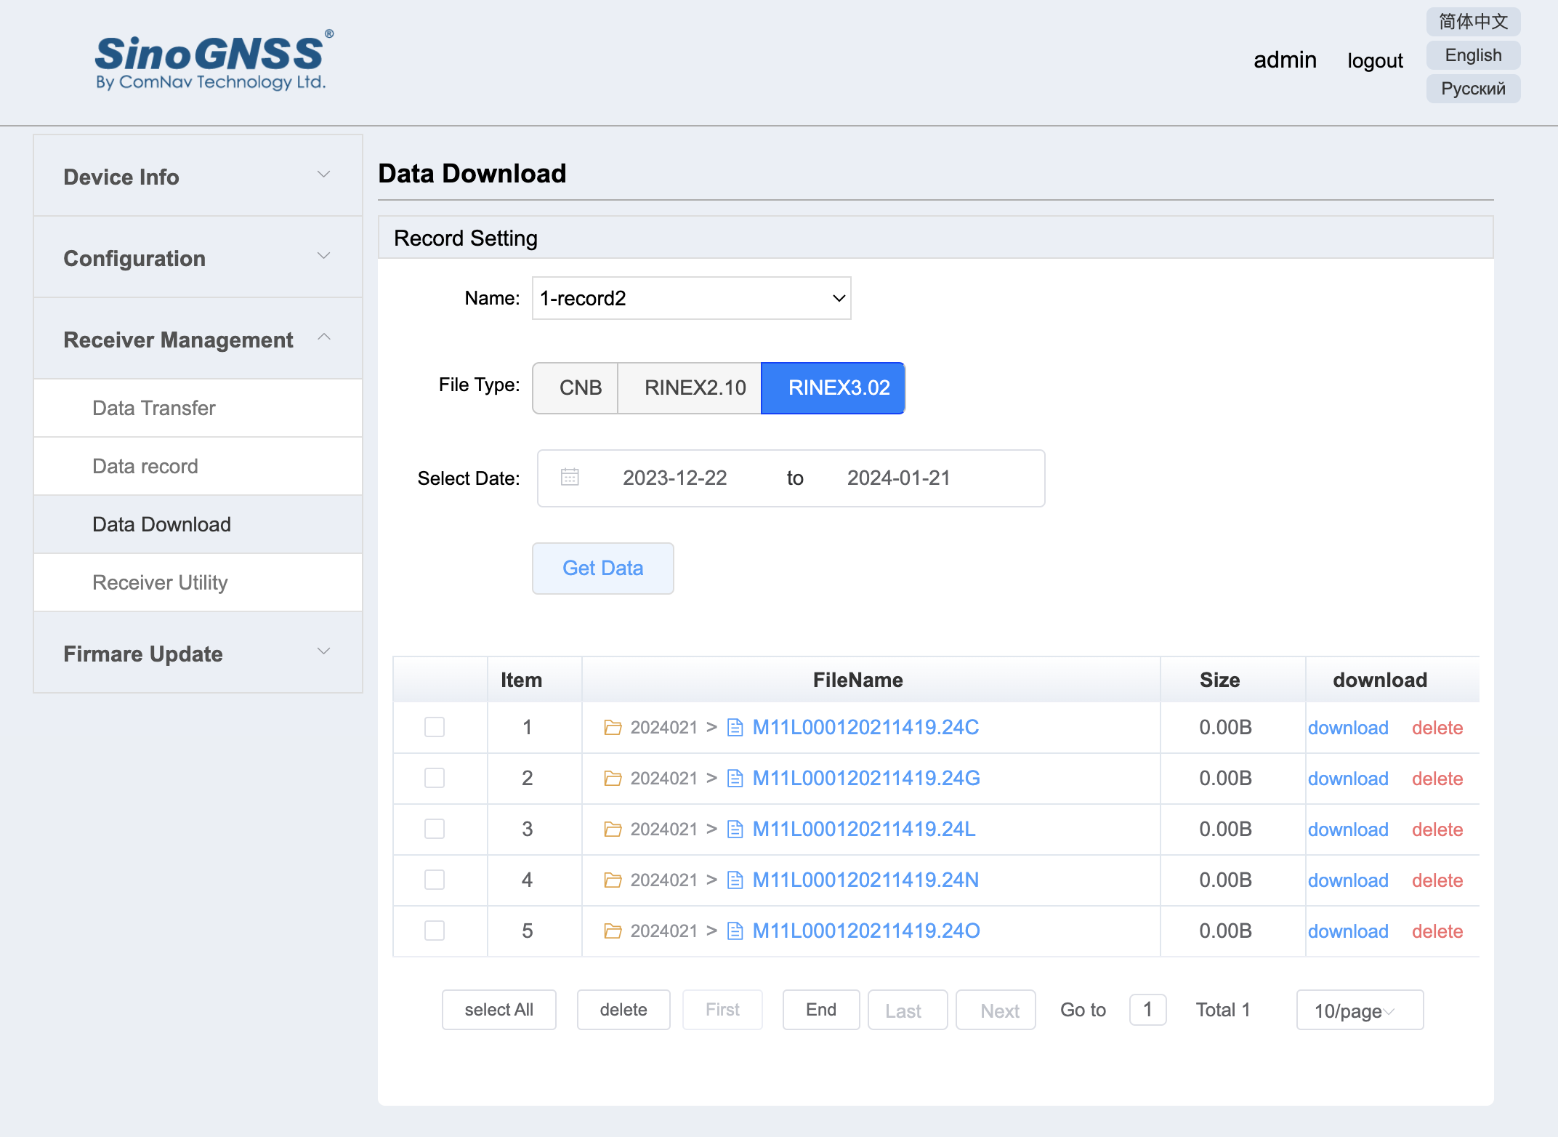
Here to download the data (in that example, not yet data, but the files are created !)
Just press download …
CGEOS SPRL

Slide 14
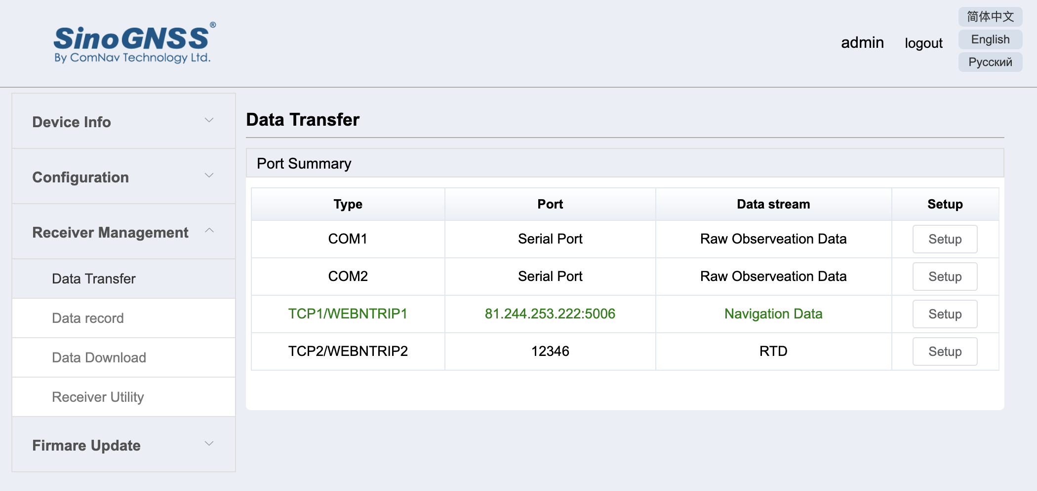
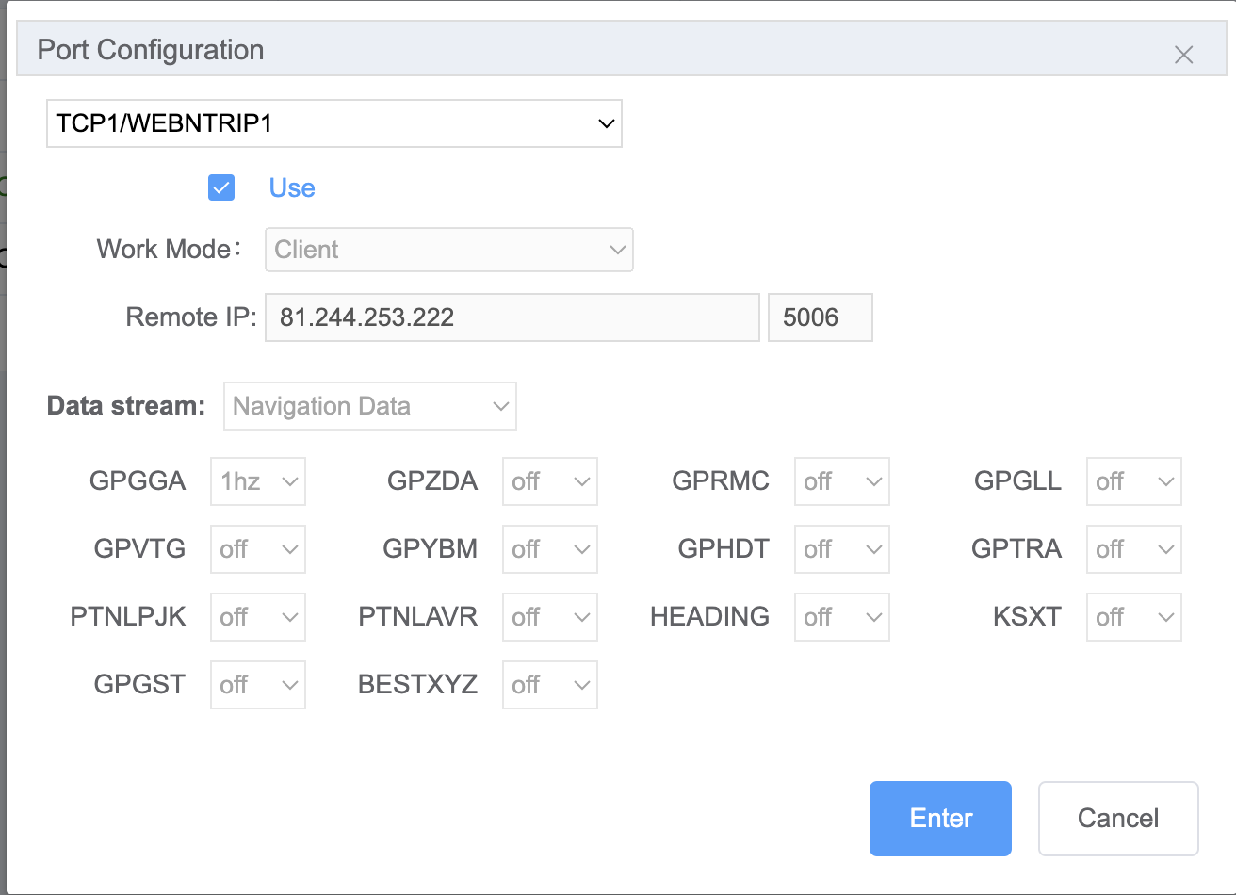
You can also stream the data to a TCP-IP server, through the COM port (LEMO USB).
We are using that functionality (streaming the navigation data to a server) for monitoring projects. You can also stream RTCM data etc, …
CGEOS SPRL

Slide 15
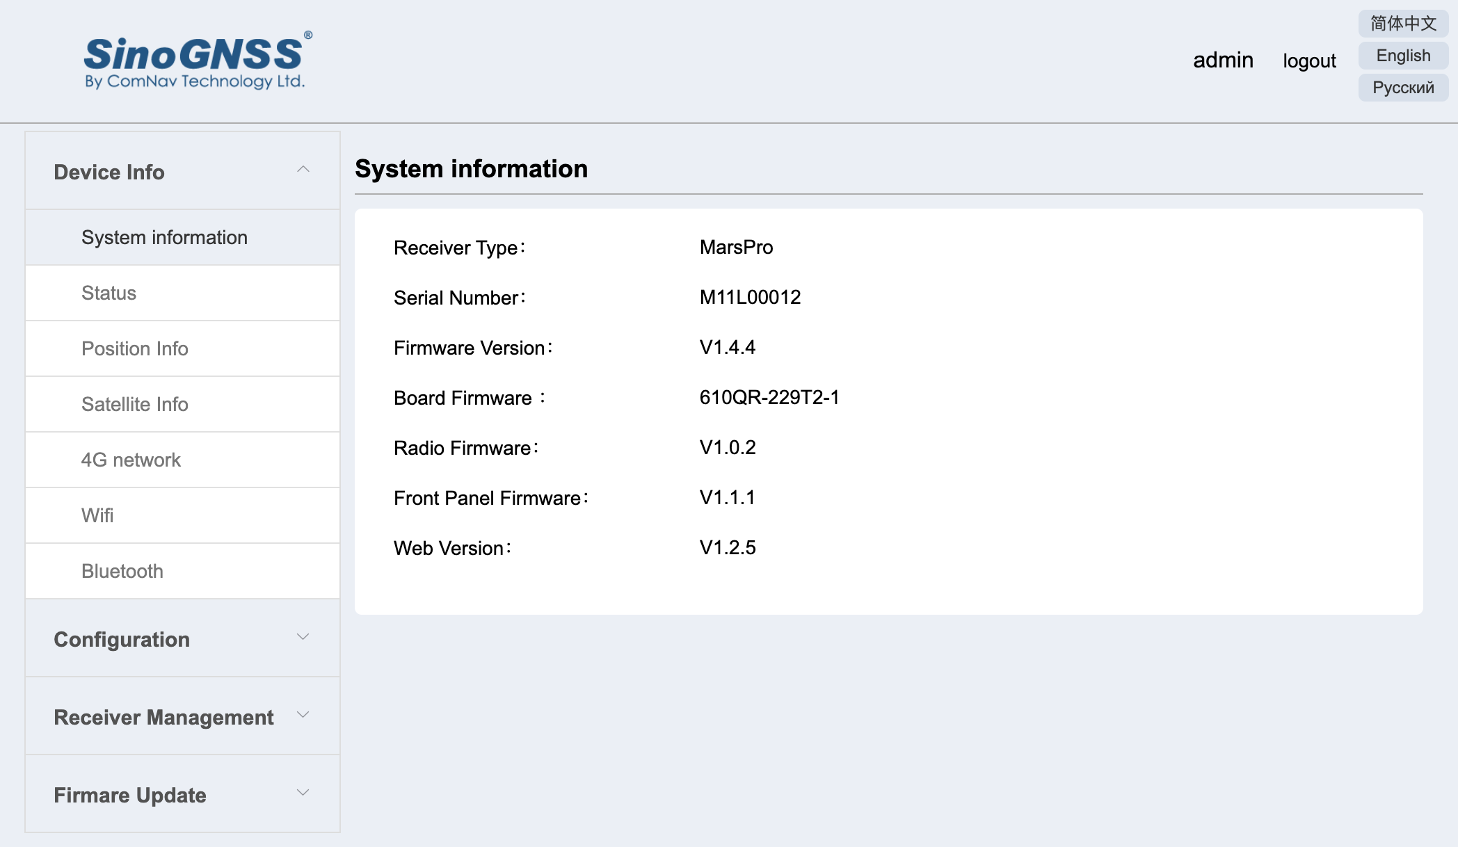
A way to check the various status !
CGEOS SPRL

Slide 16
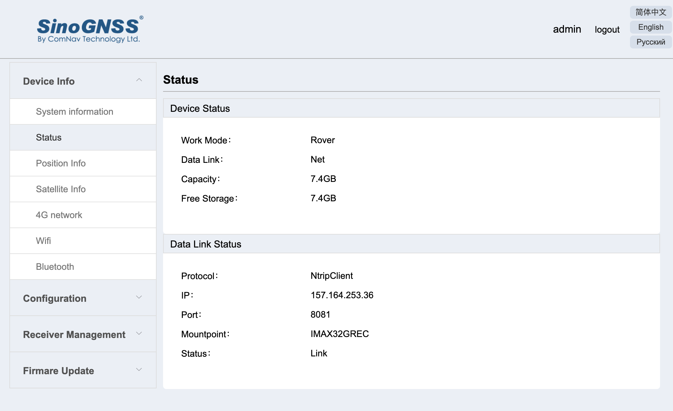
CGEOS SPRL

Slide 17
Summary
While you cannot configure the IMU (nor the laser), the Web Interface is helpful for checking the status of a GNSS receiver and eventually to configure it as NTRIP Client, stream the NMEA out through serial port or TCP-IP and store static data on the memory in RINEX format for instance.
Other receivers from ComNav are using Web Interface such the M900 and the M300 PRO K8 and that is in fact the only way to configure such receivers.
We suggest you play with the Web Interface as it can be helpful for some projects (like recording the data and not having SURVEY MASTER but just an Apple iPhone for instance) … Enjoy !
CGEOS SPRL

