Slide 1
GNSS High Precision in your Palms
Prof. Joël van Cranenbroeck, Managing Director
CGEOS CREATIVE GEOSENSING SPRL
Rue du Tienne de Mont, 11
BE-5530 MONT, Yvoir
Belgium

Slide 2
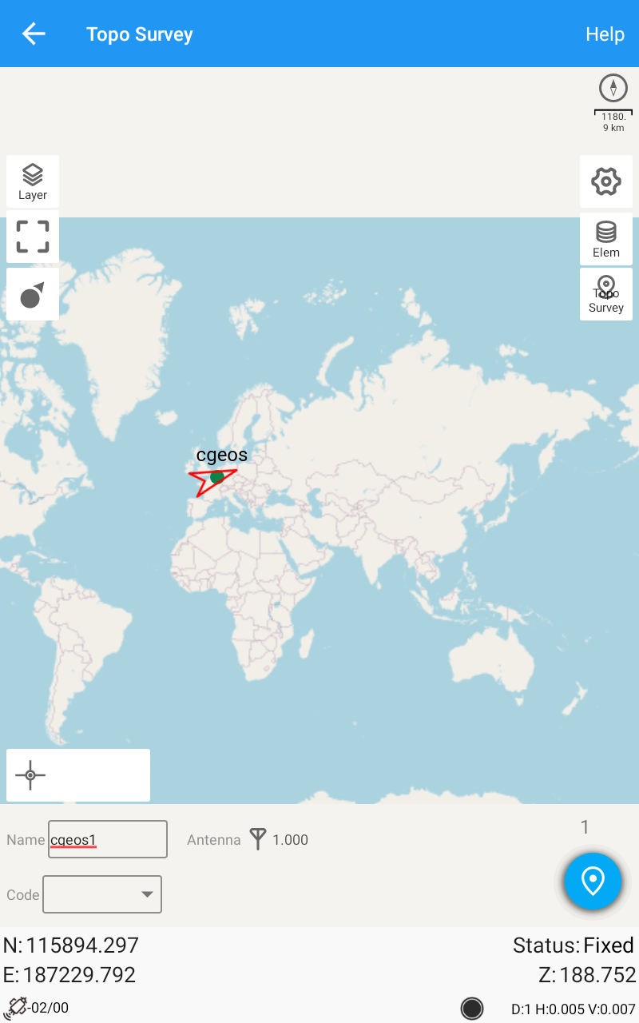
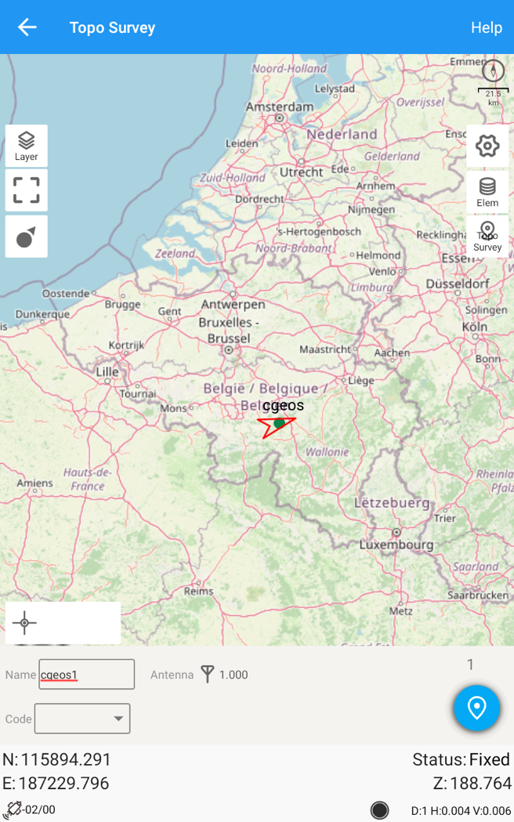
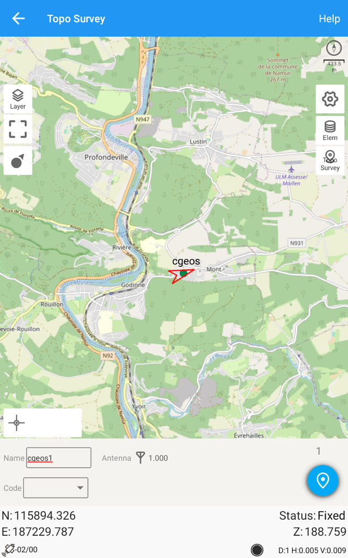

Slide 3
Introduction
Since Google introduced its GNSS API and the access to the GNSS chipset raw data that equips any Smartphone and Tablet, there are lot of excitement about addressing the mass market with GNSS high precision technology for anyone.
The University of Texas however, cool down the enthusiasts by highlighting again the importance of the GNSS antenna quality.
No (high) quality GNSS antenna = no RTK
The various investigations by the academics are fading away just because of the GNSS antenna poor quality. Physics have limits …

Slide 4
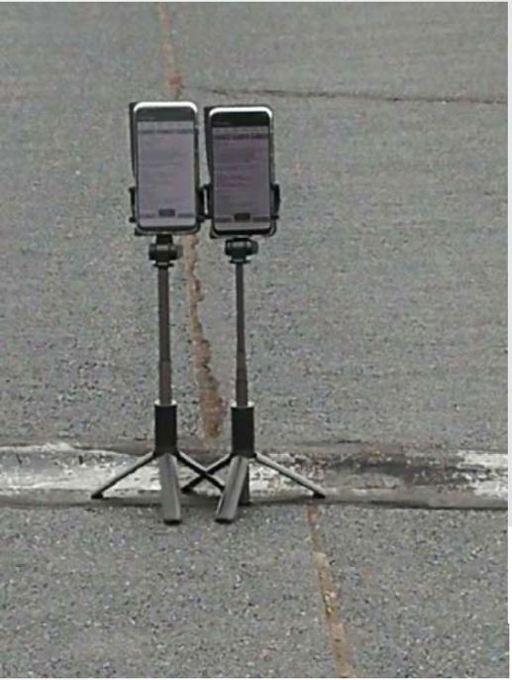
In this paper, it is strongly demonstrated that the quality of the signals collected using these technologies is completely able to reach good positioning. Surely, by combining the sensors with a better external antenna, the performances could be better, and other possible applications could be founded.

Slide 5
Only the GNSS poor quality antenna ?
To avoid sunshine on the Smartphone screen, people are turning back and the human body with 80% fluids are just blocking GNSS satellites signals from the South … SO THE ATTITUDE IS THE PROBLEM.

Slide 6
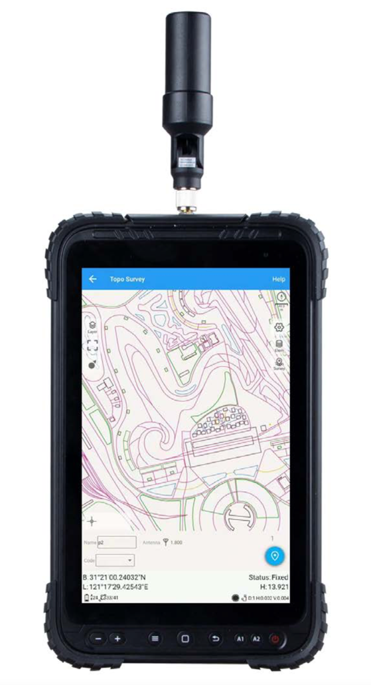
ComNav Technology Ltd. Shanghai PR CHINA is introducing the first Android Tablet with high precision GNSS module (K803) and external antenna (Helix or any other geodetic grade GNSS antenna with cable)
We, at CGEOS CREATIVE GEOSENSING SPRL Belgium, we are distributing all ComNav Technology SinoGNSS solutions since 2014.
For any new solution, we are leading intensive tests to ensure our users and customers to get the best from GNSS technology.

Slide 7
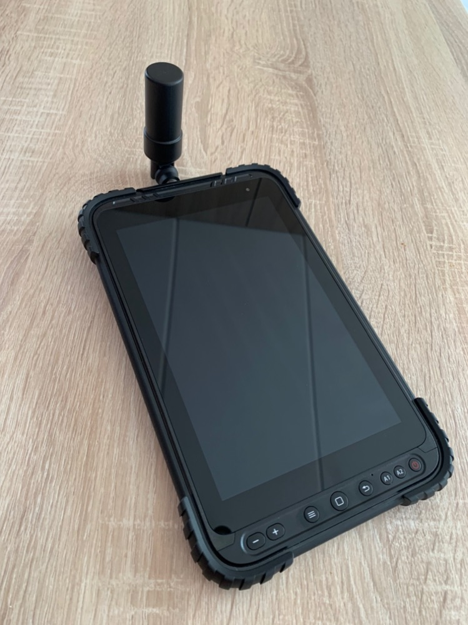
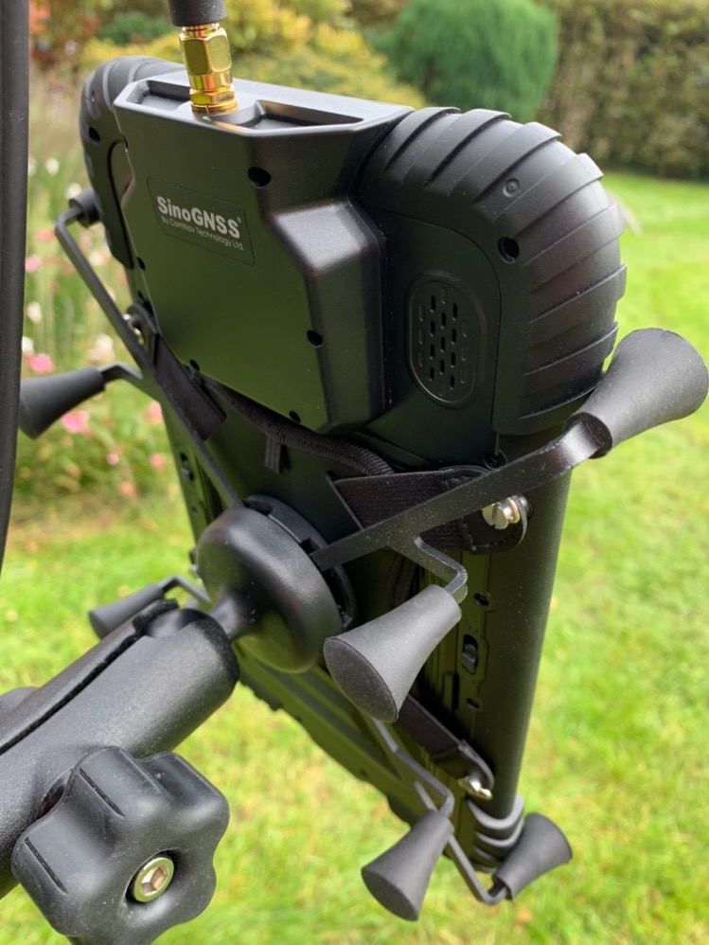
The keys for having GNSS RTK onboard a tablet is :
Very performing GNSS module such the K803
External (Helix) antenna
Software for connecting the GNSS module to a GNSS Network RTK server and delivering RTK
Software's for handling location
Good tablet hardware

Slide 8
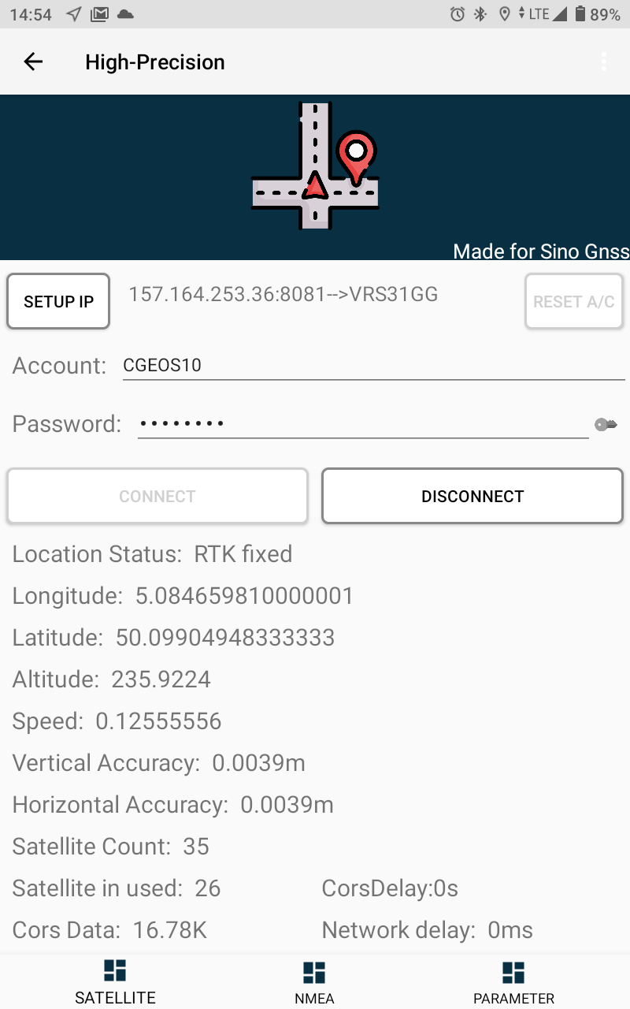
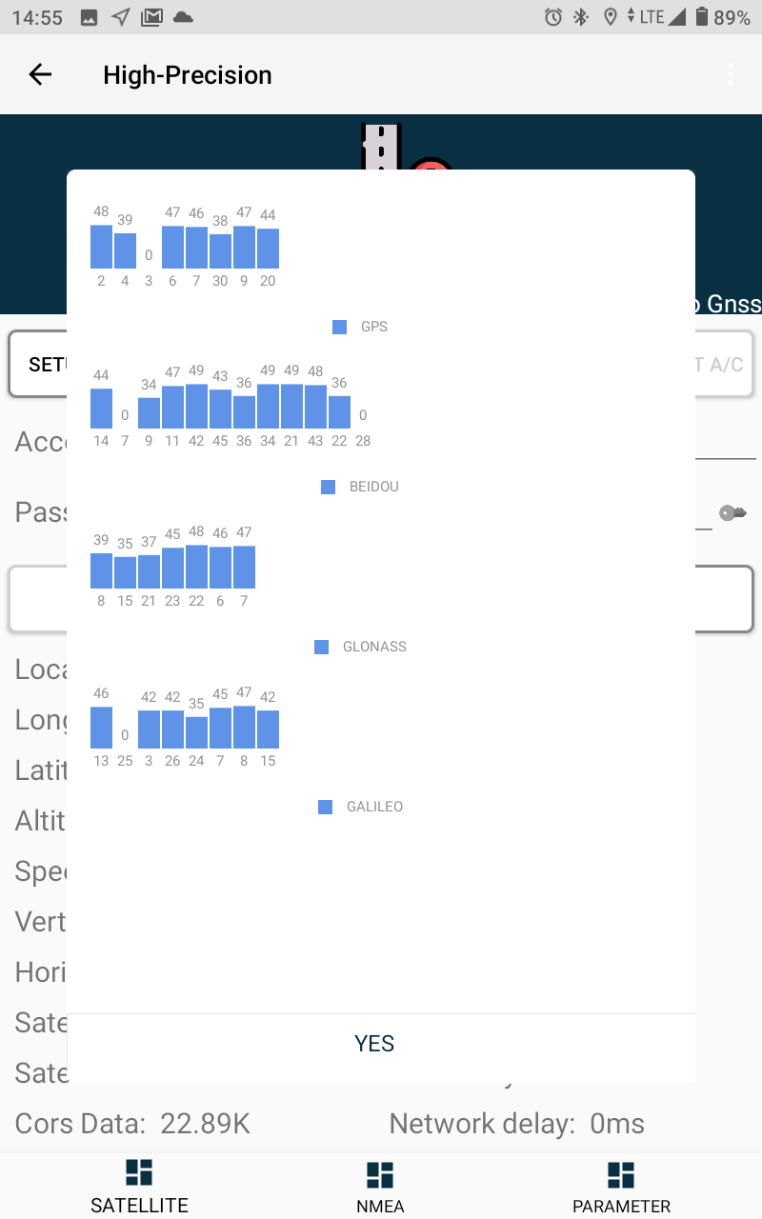
The first APP to start is the « High-Precision » App that will setup the GNSS module and connect to a GNSS Network RTK server, then link the NMEA sentences to any applications onboard the P8HP Tablet.
Then start Survey Master using Controller GNSS/Device

Slide 9
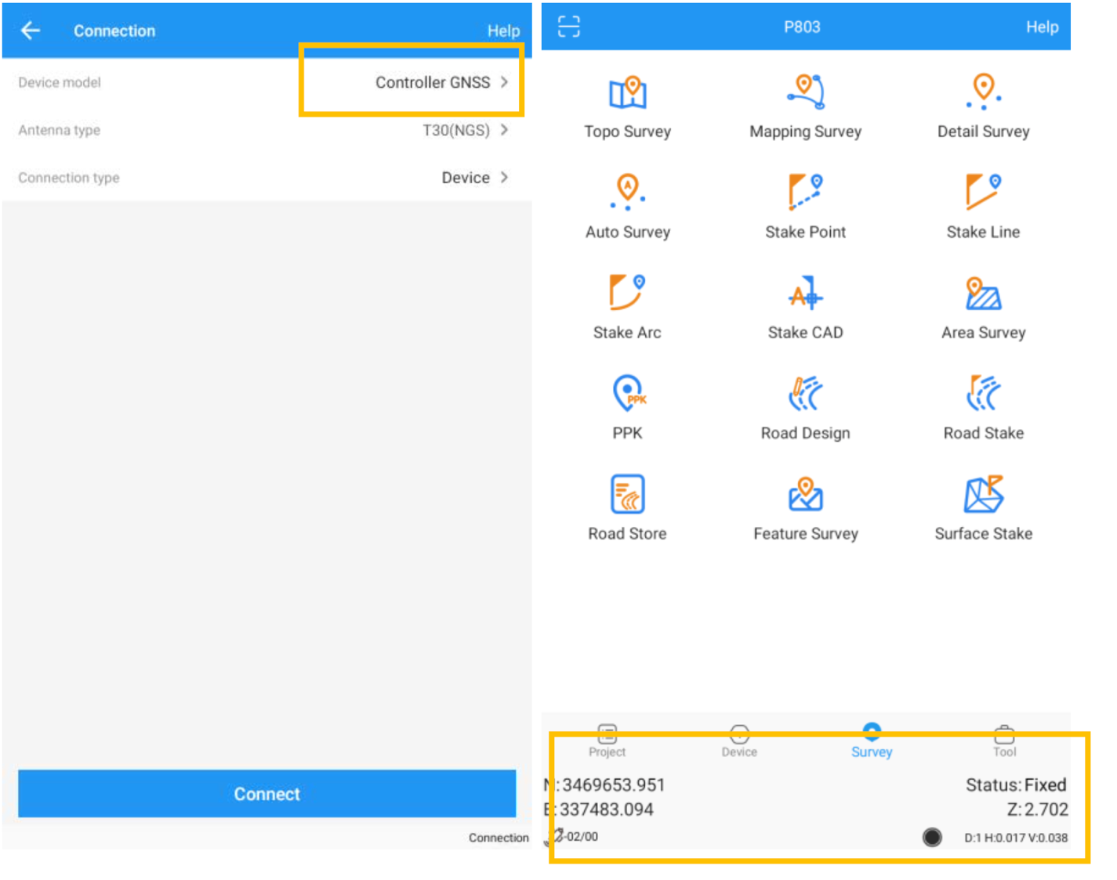

Slide 10
Just Surveying GNSS RTK
The antenna height is no more 2 meters …

Slide 11
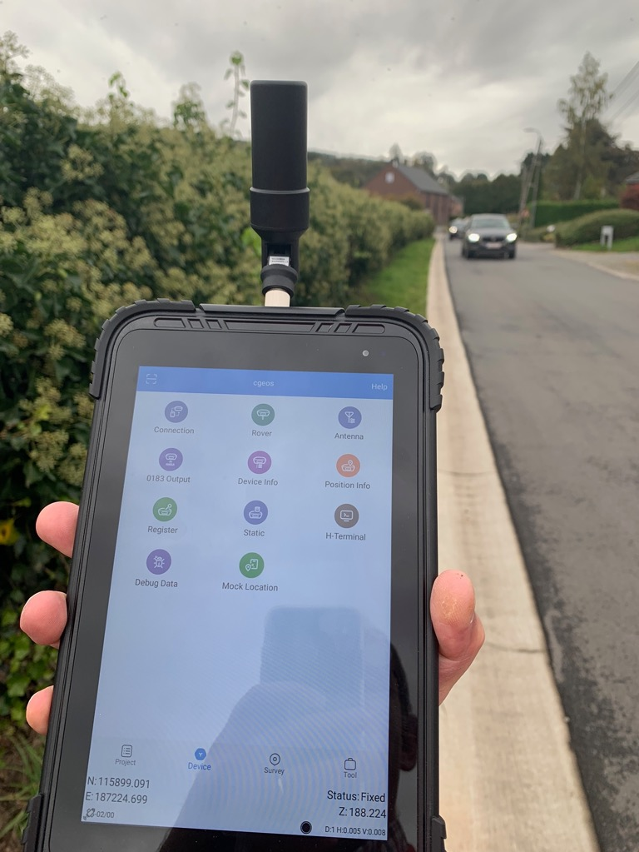
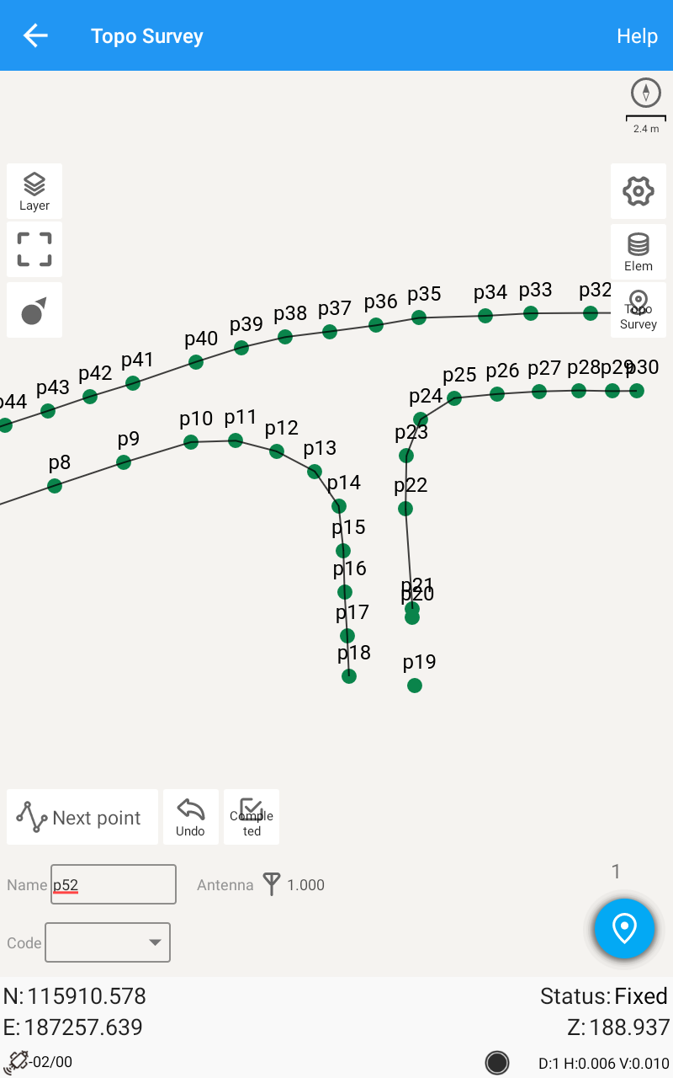
We led a simple survey along the road facing our office.
It’s very easy and simple to just collect RTK positions and use all the Survey Master features …

Slide 12
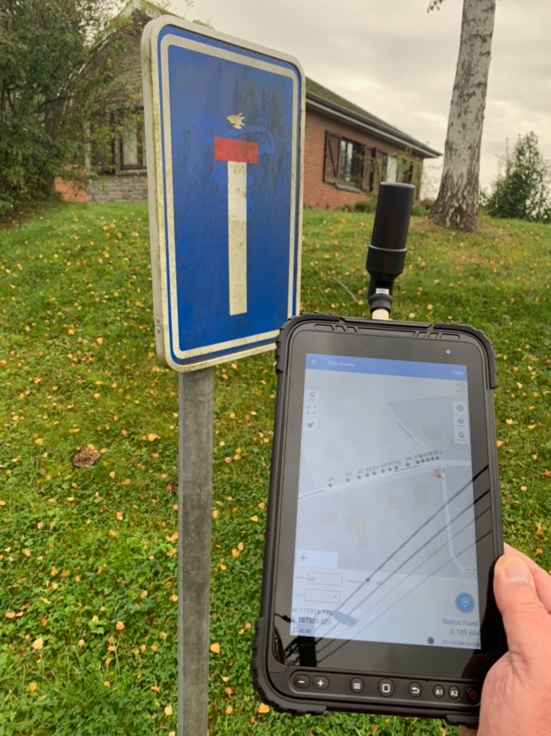
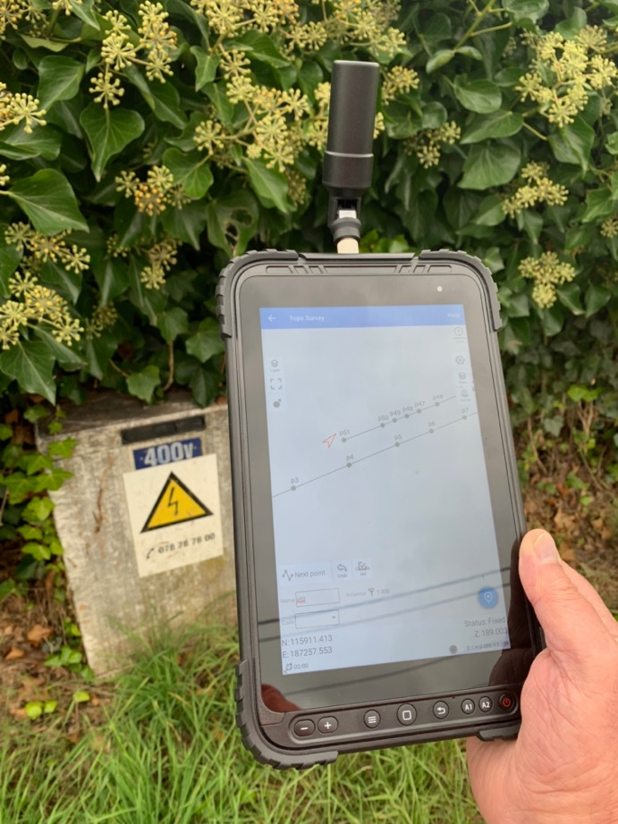
Collecting Geospatial objects with high precision will never have been so easy … and accurate !

Slide 13
Surface
Sounds great for farmers in agricultural fields or … anywhere the people wants to get surface

Slide 14
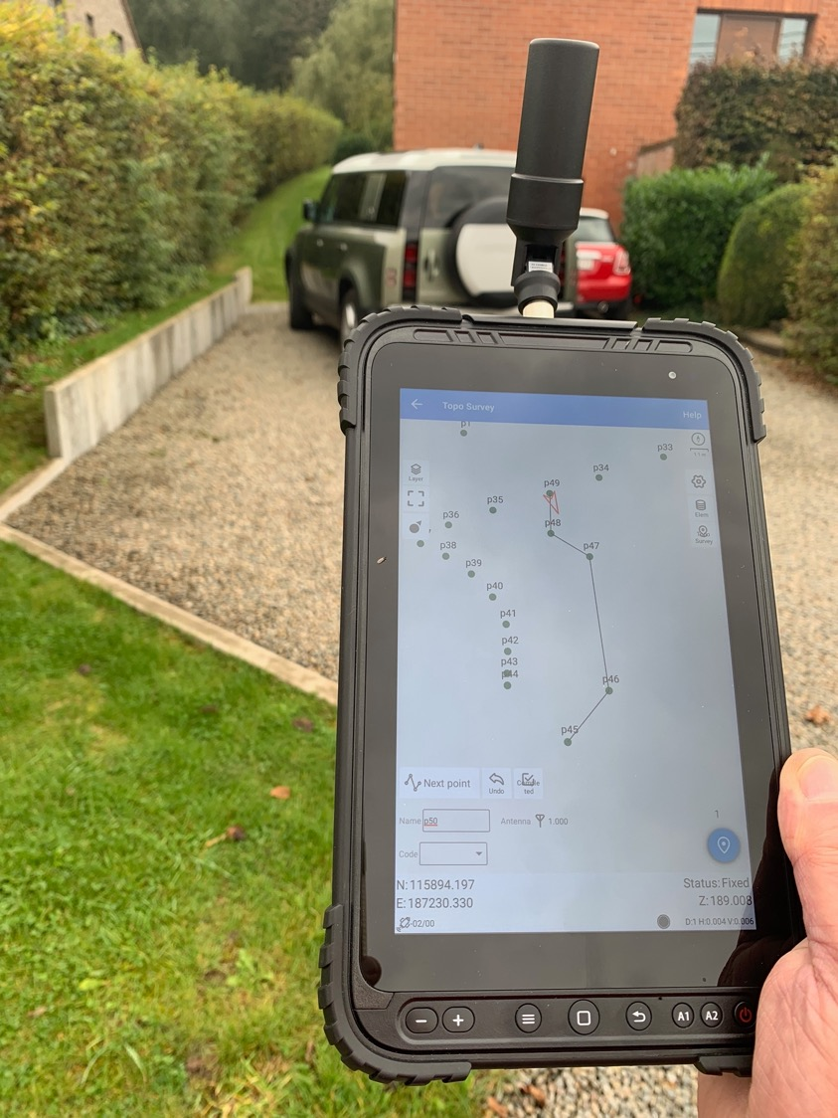
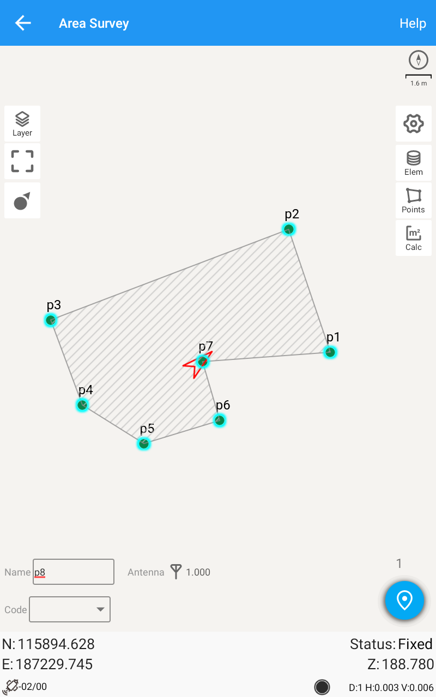
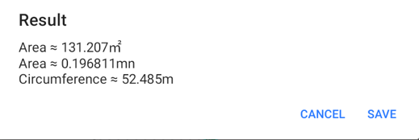

Slide 15
Digital Terrain Model
And volumes, staking out surfaces …

Slide 16
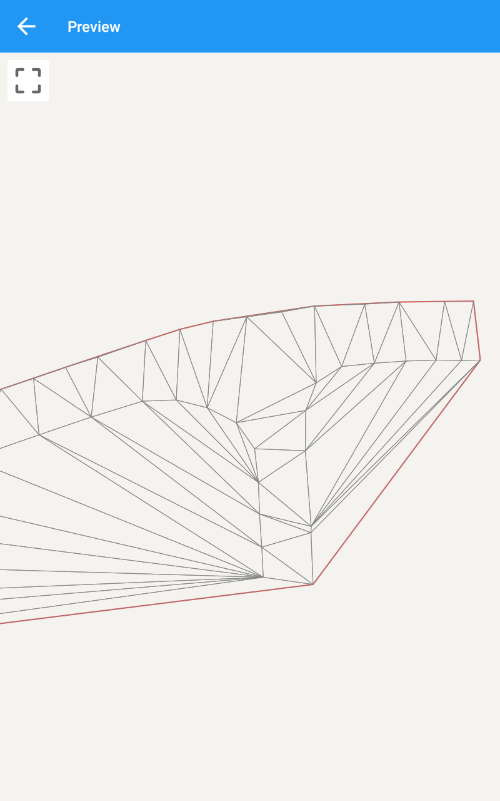
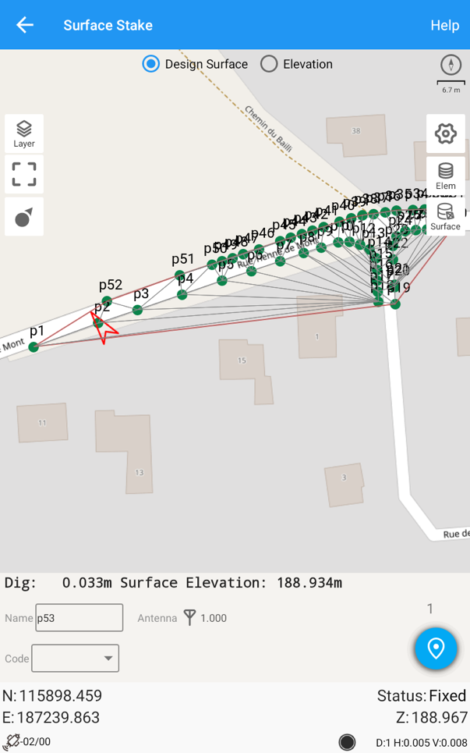

Slide 18
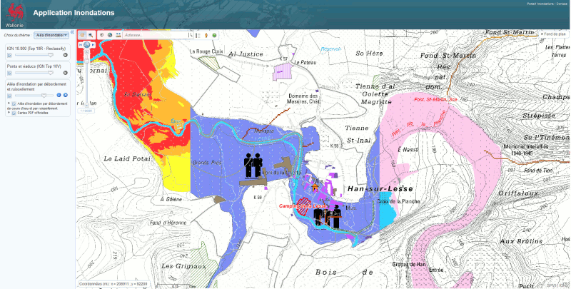
The P8HP can be a great solution for high precision positioning people and objects during flooding disasters and other natural hazards.

Slide 19
Surveying always
Using geodetic grade external GNSS antenna

Slide 20
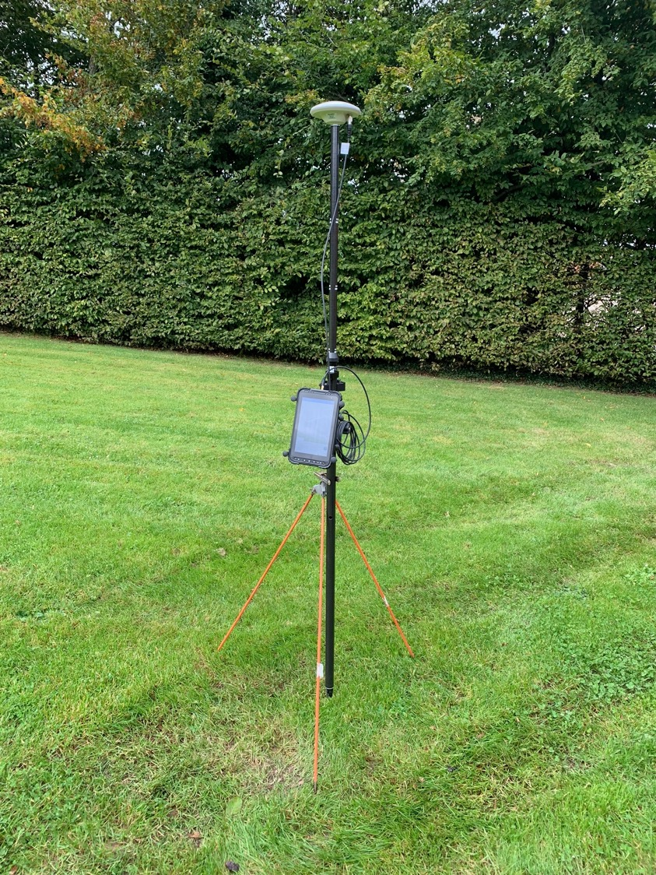
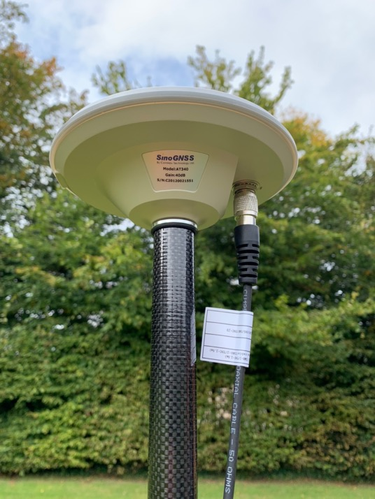
By connecting an AT340 with the antenna cable on the P8HP tablet, you get a surveying receiver that can clearly compete with the wearable GNSS G100/G200. The benefit is that the P8HP is already a tablet running Survey Master …

Slide 21
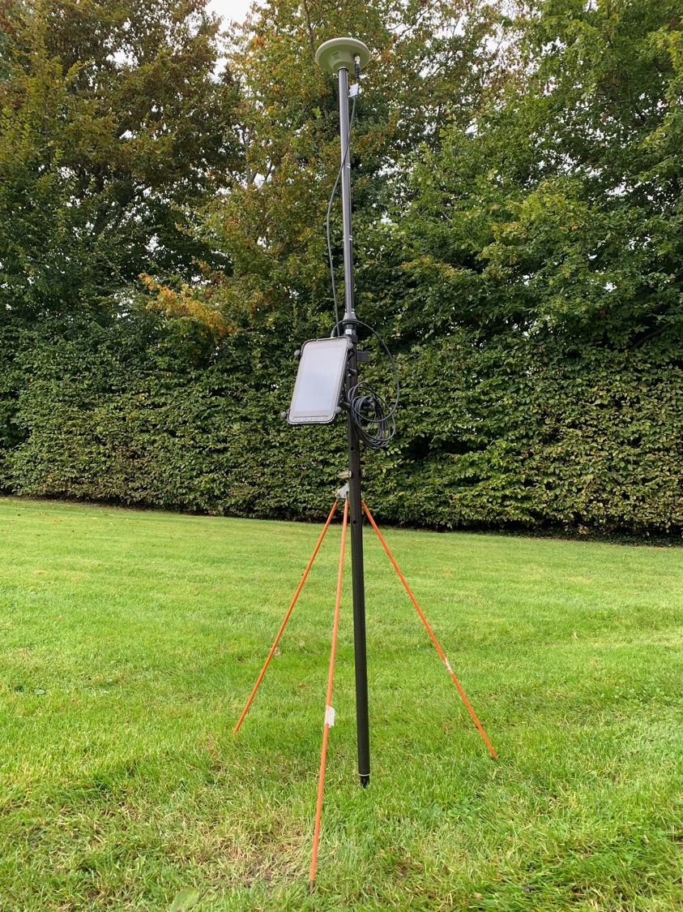
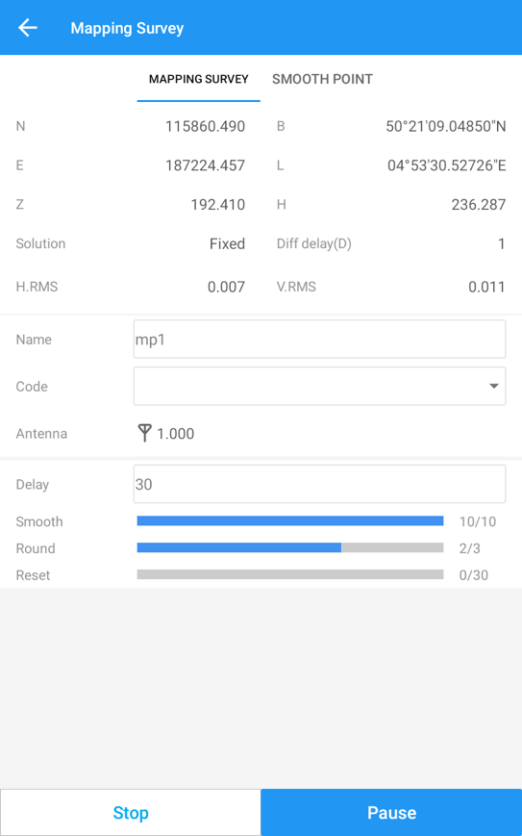
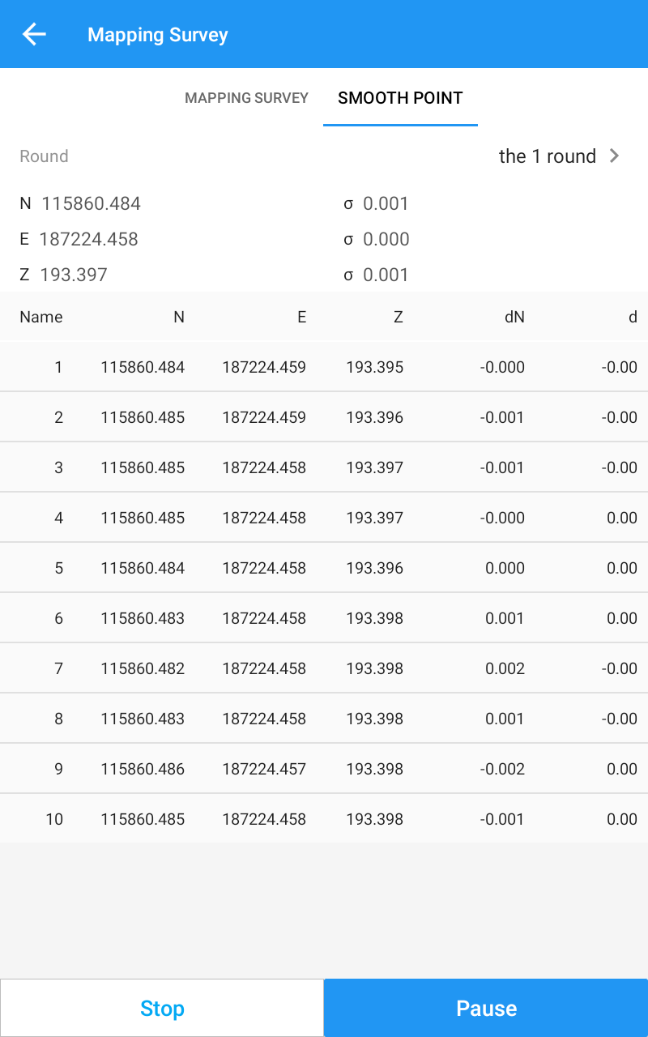
The P8HP can be turned easily into a GNSS RTK surveying tool.

Slide 22
What next ?
Opening the GNSS Mass Market …

Slide 23
An Opportunity …
The SinoGNSS P8HP is offering us the unique opportunity to open the GNSS High Precision Technologies for the Mass Market !
Now we now the How … but who and where and why ?
Since years now, marketeers are announcing GNSS High Precision for the Mass Market ! But does the street people needs high precision location ?
Probably the professionals will still be the main adopters of the P8HP
But it’s an opportunity to look for more applications …
Because that will be the applications that will drive that business !

Slide 24
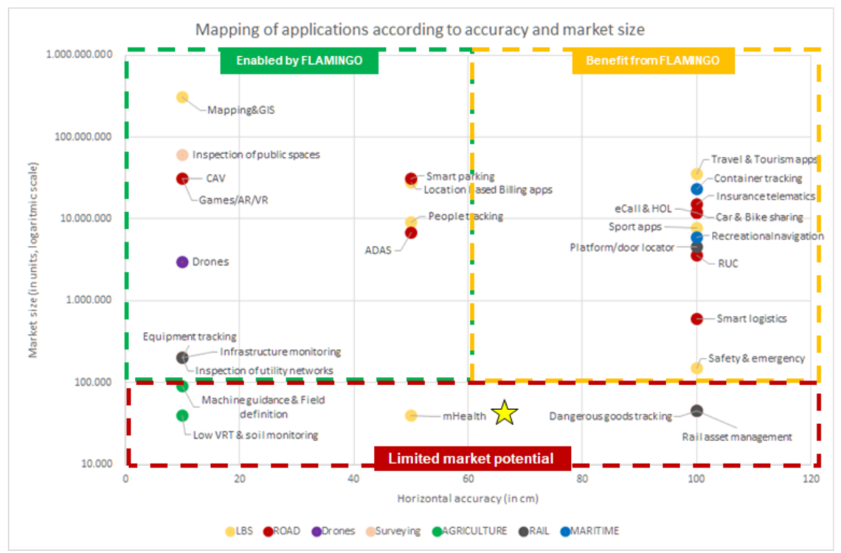
Google Maps exceeding 1 billion active users. Also, Google Play quotes there are 47,000 free Maps & Navigation applications alone. Currently, however, mapping and GIS applications in IOT and smartphones is limited to accuracies over a meter and is restricted in terms of availability in the urban canyon.
Improving this accuracy will allow users to explore their environment with a greater awareness, such as the end of a sidewalk or the lane of a highway. In GIS, an amateur surveyor may be able to map the size of their garden or driveway. Currently, such capabilities are unavailable in mass-market receivers.
Enabled by P8HP
Benefit from P8HP

Slide 25
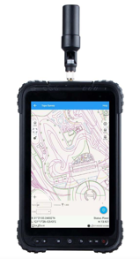
New Market Segments …
Inventories in construction, extraction industries and industrial areas

Slide 26
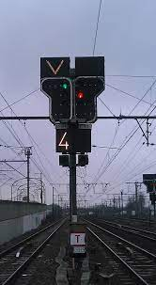
New Market Segments …
Railway, signals and inspection

Slide 27
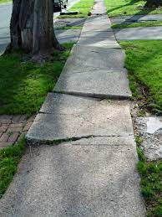
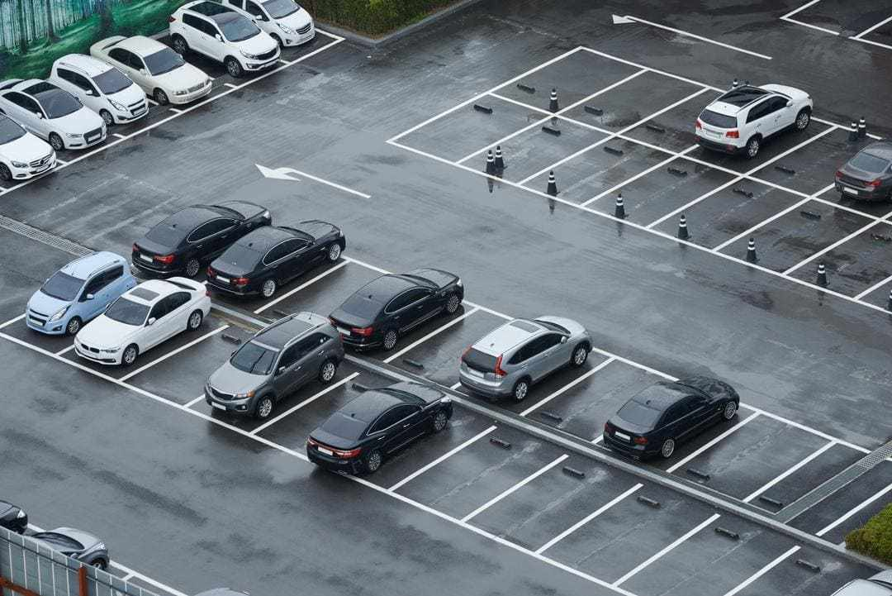
New Market Segments …
Inspection of public spaces, public parking lots, infrastructures

Slide 28
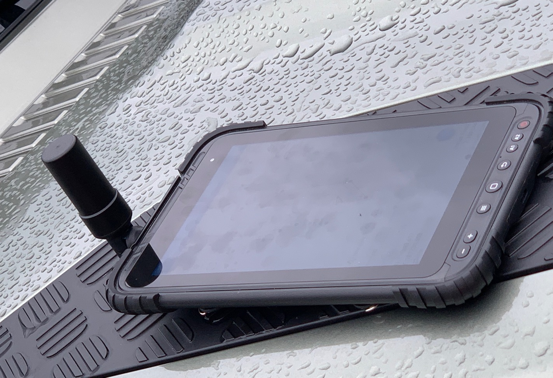
Prof. Joël van Cranenbroeck, Managing Director
CGEOS
CREATIVE GEOSENSING SPRL
E-mail : cgeos2014@gmail.com
Mobile +32 474 98 61 93

