Slide 1
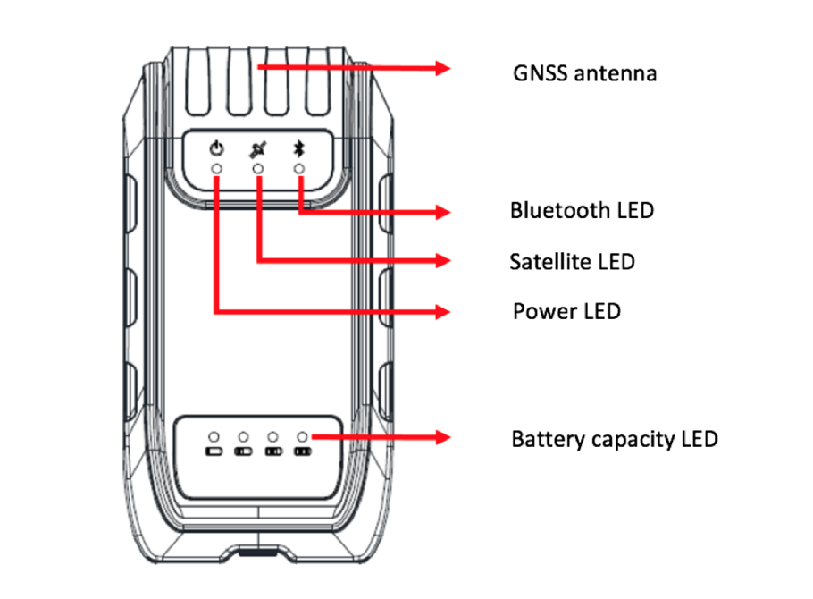
Only G100
The G100 can be connected to the internal GNSS antenna, the one at the top of the box AND also be connected to an external GNSS antenna via an antenna cable.
The G100's internal antenna also supports EGNOS corrections (on the L band) in Europe and other SBAS worldwide …
On the other hand, the G200 is not connected to the internal antenna and therefore MUST be connected to an external antenna of the AT330 type, for example.

Slide 2
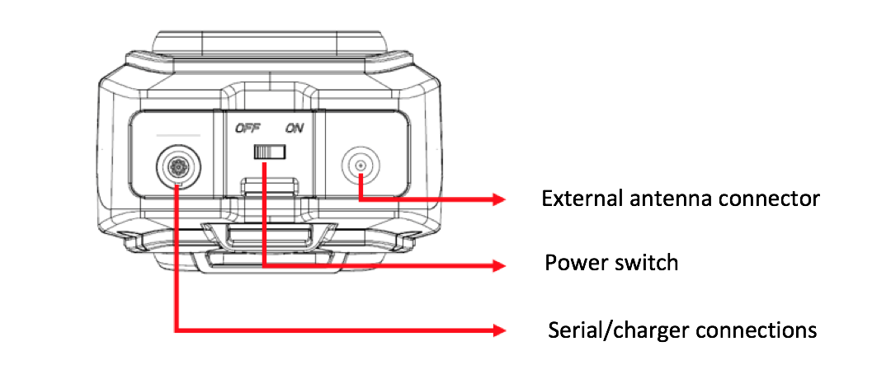
The "data" interfaces of the G100 / G200 are of the BlueTooth (BT) and serial RS-232 type configured at 115200 baud by default.
The serial interface (cable) is COM1
The Bluetooth (BT) interface is COM3
This information is very important to be able to re-route for example the NMEA frames from one or the other port (COM1 with cable, COM3 via Bluetooth)

Slide 3
INTERFACES for the G100/G200
With its minimalist architecture, the G100 / G200 offers exceptional agility!
For a professional user, there are several ways to "drive" the G100 / G200
Using an Android R500 PDA or Android Smartphone / Tablet with the free SURVEY MASTER app developed by ComNav Technology Ltd. Shanghai, PR CHINA
Using a R100 / R200 PDA with CARLSON SurvCE software, MicroSurvey FIELDGenius and CGSurvey also developed by ComNav Technology.

Slide 4
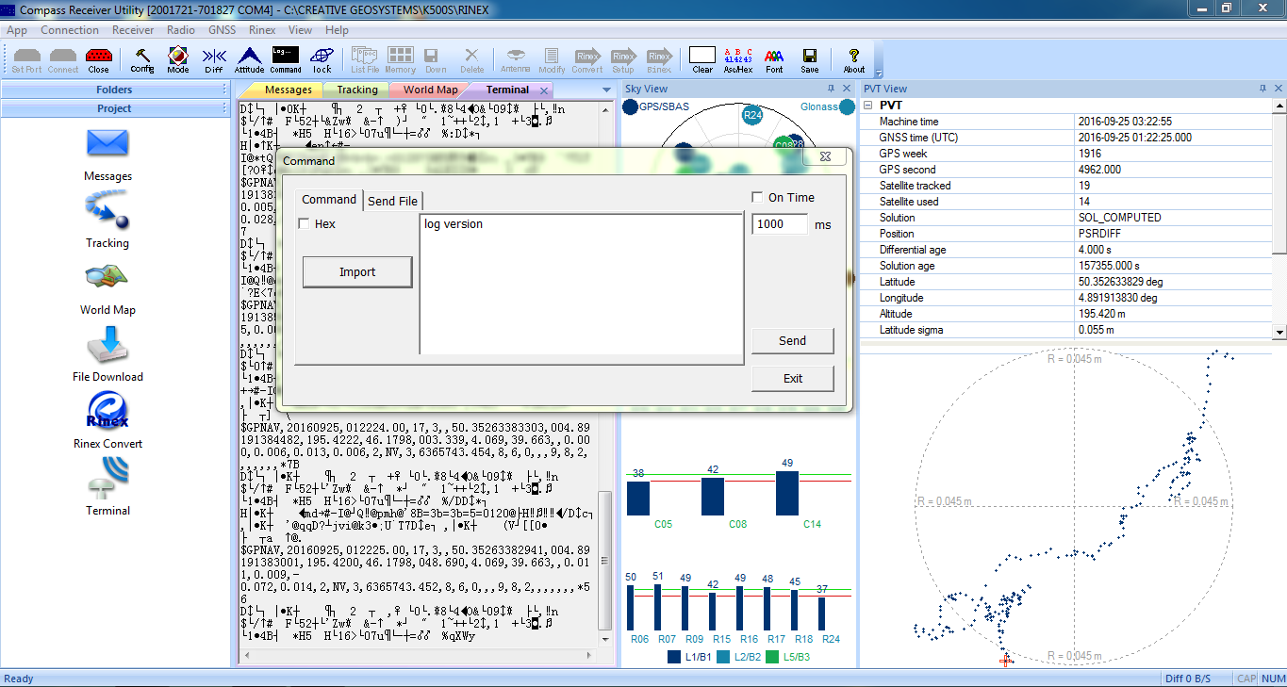
The configuration of the G100 / G200 can be handled via the CRU.EXE software downloadable from the ComNav Technology Ltd. website. The "COMMAND" window is used to enter the commands. Note that any RS-232 terminal can also be used as PUTTY for example ...
http://www.comnavtech.com/download.asp?bigclassid=28

Slide 5
G100/G200 – Open System
Unlike many GNSS receivers, the G100 / G200 is an "open" system that allows for sophisticated configuration using simple TEXT/ASCII commands.
These commands are sent via the Bluetooth or serial RS-232 port and allow for example to configure the DGNSS mode under SBAS.
You can use an RS-232 terminal and of course the CRU.EXE software from ComNav Technology.
These commands can also be sent by any software.

Slide 6
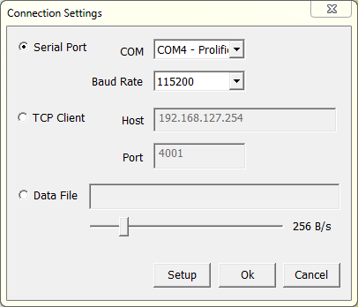
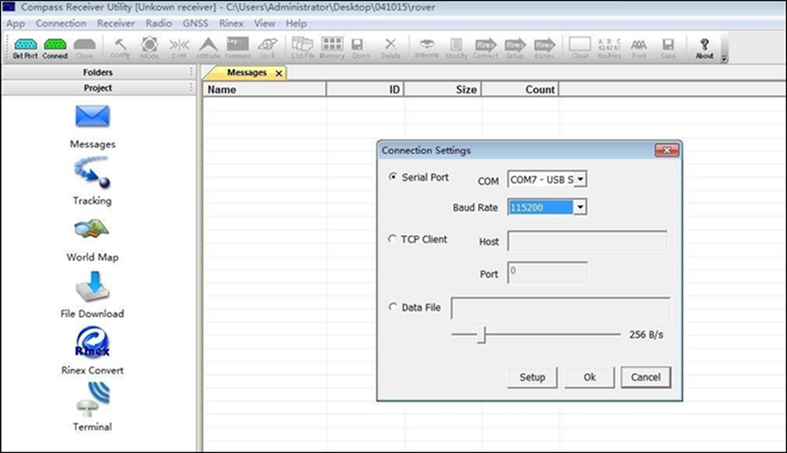
The connection between CRU.EXE and the G100 / G200 is via the RS-232 serial cable or the Bluetooth interface. In both cases, CRU.EXE will present the COM ports associated with the G100 / G200. The transfer rate is 115200 Baud (bit / second).
To configure the Bluetooth port on a Windows PC, search for the G100 / G200 and associate an RS-232 port. It will work just like any RS-232 COM port but will interface with Bluetooth!

Slide 7
Commands for configurating the G100/G200
The commands are of "text" type and must be introduced exactly as they are presented ending with an "Enter" (ENTER = CRLF) including the last command which is generally "SAVECONFIG" to permanently save the entered configuration.

Slide 8
COM3 = BT port
COM1 = RS-232

Slide 9
The NMEA frames
NMEA frames consist of different data and are prefixed by a 6 letter identifier ($ GPGGA, $ GPGGL, ...) starting with a "$" and GP (for GPS)
$ GPGGA, 125010.00,5021.1586910, N, 00453.5158690, E, 7,18,0.6,242.9083, M, 0000, M,, * 64
NMEA frames are used by many GIS and other software to retrieve data from a GNSS receiver
The command to be introduced is:
LOG COM(n) GPGGA ONTIME 1 (+ Enter) n = 1 or 3
COM1 = serial cable ... COM3 = Bluetooth connection
$GPGGA is the GGA NMEA frame
ONTIME 1 = every second. We can also use 0.2 for 5 Hz for instance

Slide 10
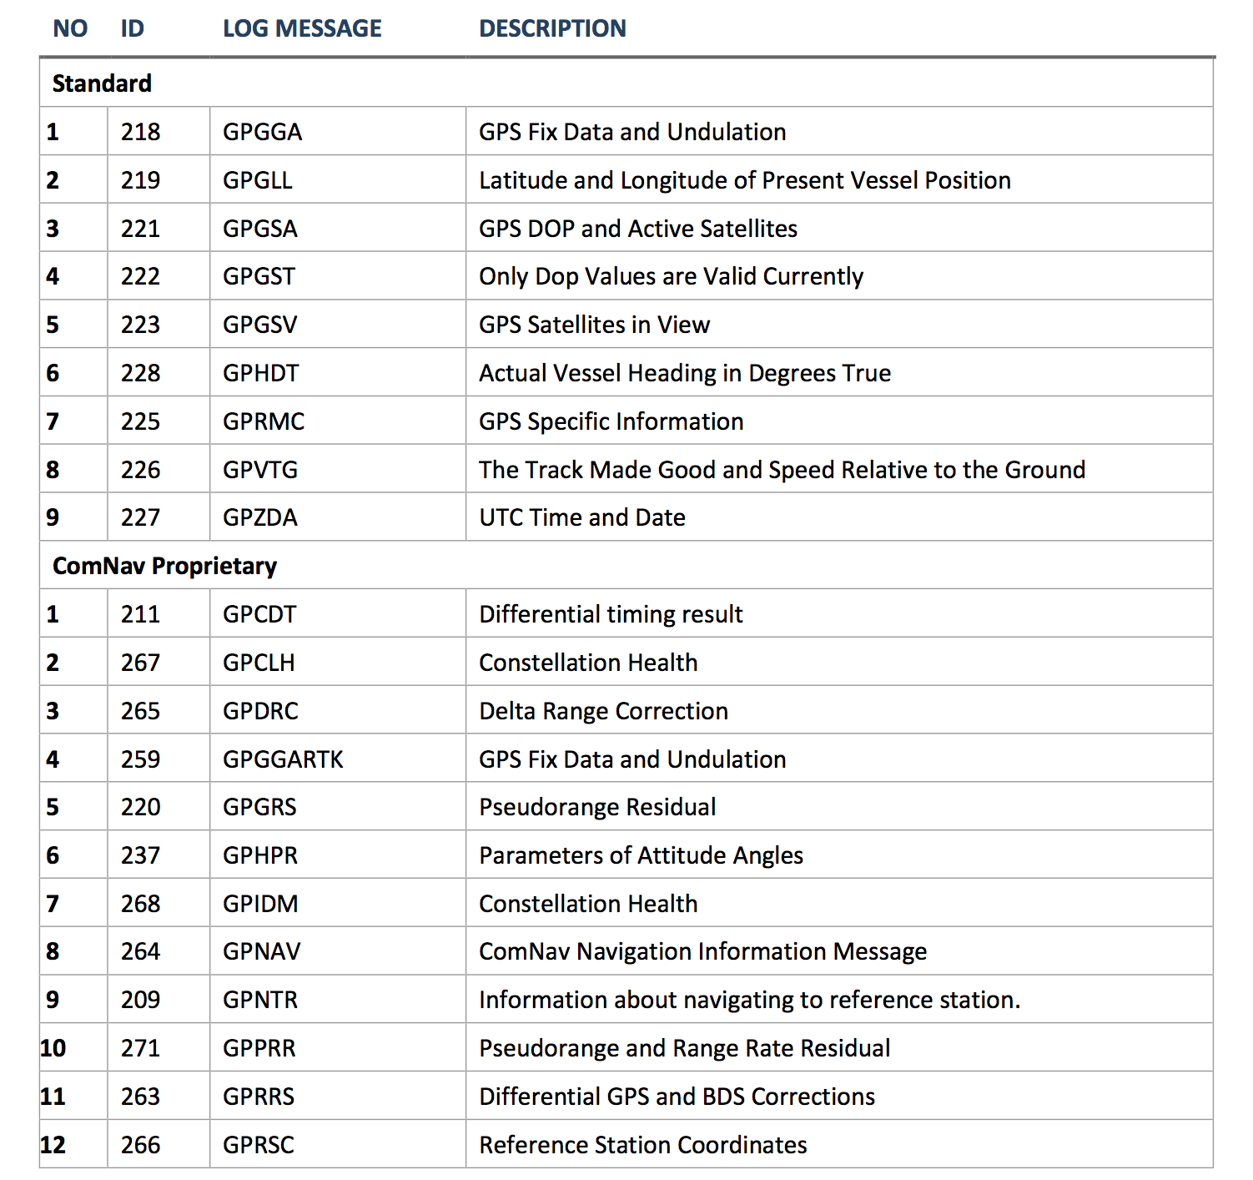
NMEA frames
Available frames listed
Generally the following frames are used:
GPGGA
GPRMC
GPGSA
GPGSV
...
Check what your software requests as frames and if you do not see all the information, it is often a frame is missing!

Slide 11
THE COMMAND LOG COM(n) GPGGA …
If we want to stream out the $GPGGA NMEA frame via RS-232 serial :
LOG COM1 GPGGA ONTIME 1 (CRLF = Enter)
If we want to stream out $GPGGA via the Bluetooth:
La commande à introduire est :
LOG COM3 GPGGA ONTIME 1 (+ Entrée CRLF)
If we want to clean all messages just use “UNLOGALL” and if only for a given port “UNLOGALL COM3” for instance.
If we want to reset the receiver use the command “FRESET” and wait for the receiver to reboot ...

Slide 12
Let summarize …
We have already learnt about the following commands :
UNLOGALL (COM1 ou COM3)
LOG (COM1 ou COM3) GPGGA ONTIME 1
FRESET
LOG VERSION (that’s the default command that popup in the CRU.EXE software)
We learnt also that COM1 is the serial RS-232 port (cable) and that COM3 is the Bluetooth port !

Slide 13
Configurating EGNOS (in Europe)
The G100 thanks to its internal or external antenna, can receive differential corrections of the SBAS type and in Europe EGNOS. EGNOS is a GNSS "augmentation" which consists of calculating and sending corrections to GNSS receivers via the L frequency band (geostationary satellite).
For more information on EGNOS: https://www.gsa.europa.eu/egnos/what-egnos
The positioning accuracy obtained with the EGNOS corrections is typically sub-metric and even of the order of several tens of decimetres. Typically exploited for agriculture, GIS data collection, navigation etc., ...
So you have to configure the G100 to receive these corrections ...

Slide 14
Commands for configuring EGNOS
The 3 following commands must be introduced and ended by a CRLF = Enter. Do not forget also the last line otherwise that command will be ignored :
SBASCONTROL ENABLE EGNOS
RTKOBSMODE 3
SAVECONFIG + CRLF … that’s the ENTER key on your keyboard
And to wait that the navigation flag status switch to 2 (it takes around 5’ the first time)
$GPGGA,125010.00,5021.1586910,N,00453.5158690,E,2,18,0.6,242.9083,M,0.000,M,,*64
To disable the use of EGNOS :
SBASCONTROL DISABLE
RTKOBSMODE AUTO
SAVECONFIG + CRLF … that’s the ENTER key on your keyboard

Slide 15
The INTERFACEMODE command
The INTERFACEMODE command followed by the parameters makes it possible to place the receiver in RTK mode or to return to the "introduce commands" mode!
If indeed it does not seem possible to introduce commands (via CRU.EXE for example) and you have no validation that they were understood by the receiver, the command INTERFACEMODE COMPASS COMPASS ON will greatly help you!
INTERFACEMODE (COM1 ou COM3) COMPASS COMPASS ON
SAVECONFIG (do not forget ENTER)
To set the receiver in "mobile RTK" mode! As soon as the port concerned is configured, all the RTCM frames will be interpreted as coming from a base station and the receiver will set the phase ambiguities fixation process.
INTERFACEMODE (COM1 ou COM3) AUTO AUTO ON
SAVECONFIG (do not forget ENTER)

Slide 16
How to pair the G100 / G200 with an Android OS application?
By configuring the G100 / G200 to output the NMEA frames according to COM1 communication port (cable) and / or COM3 (BT), it is obviously necessary that the software you use receives these data!
Where it gets complicated is when your device uses the built-in GPS chipset (smartphone case or android tablet!) by default and there is no way to configure another external receiver.
The trick is to "route" the smartphone to an external receiver via the Bluetooth link. It's simple but a bit confusing!

Slide 17
The trick is to activate the "mock location" option and assign it to the MapIt application for example.
Mock Location is a virtual GPS simulator generated by Android R & D to help developers use a Smartphone that does not have a GNSS chipset to check their developments.
By activating "Mock Location" your Smartphone will generate dummy positions from an application and no longer from GPS / GNSS chipset If you allow for instance MapIt to be associated with »Mock Location", the external GNSS receiver will be used instead of the Smartphone internal chipset GPS / GNSS ... That's it ... it's over and it's the first "trick"!
In summary:
You must activate "Mock location" on your Smartphone to force the coupling of an external GNSS, otherwise the Smartphone will use its internal GPS and its WIFI as the main LBS device.
To enable or disable "mock location" on a smartphone, you must first enable the developer option on your Android. By default, the developer option is not enabled on any device. Users must enable the developer option manually. This is the second »trick"!
So, thoroughly understand the mechanism of the "mock location" and then the activated and associated with the application you use. Again, if you use SURVEY MASTER ... you will not have to go through these steps.

Slide 18
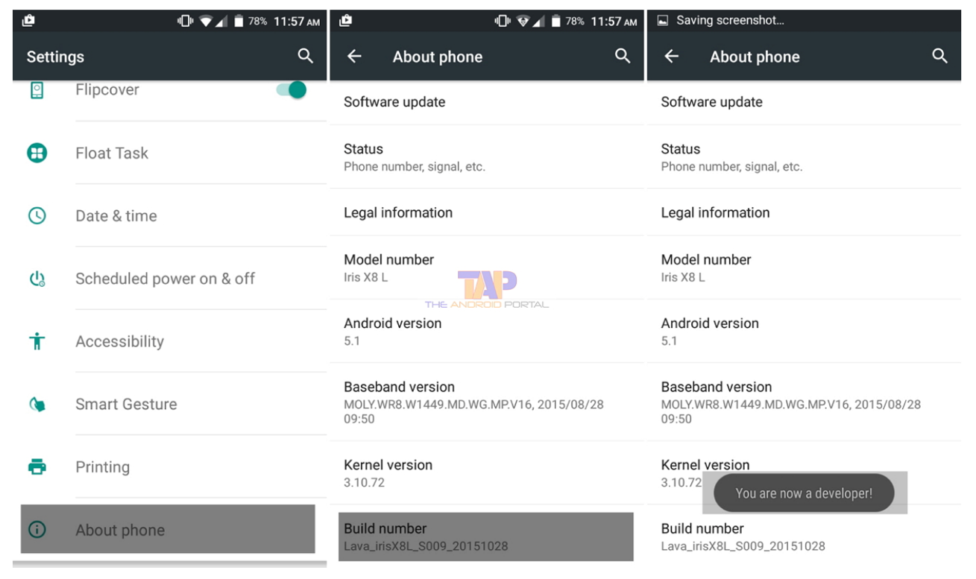
How to enable the Developer option on any smartphone
1. Start "settings" on your phone first
2. Scroll down and select About the phone (About)
3. In the About Phone section, scroll down and find the Build Number options.
4. Now, click seven times (7) on the build number options
5. After typing seven times, you will see a small pop-up message on your screen "You are now a developer!"
6. After this message, you can access the developer option on your phone. You can now access your fictional locations on your phone and enable / disable it. Follow these steps to enable and disable the fictitious location on your Android smartphone.

Slide 19
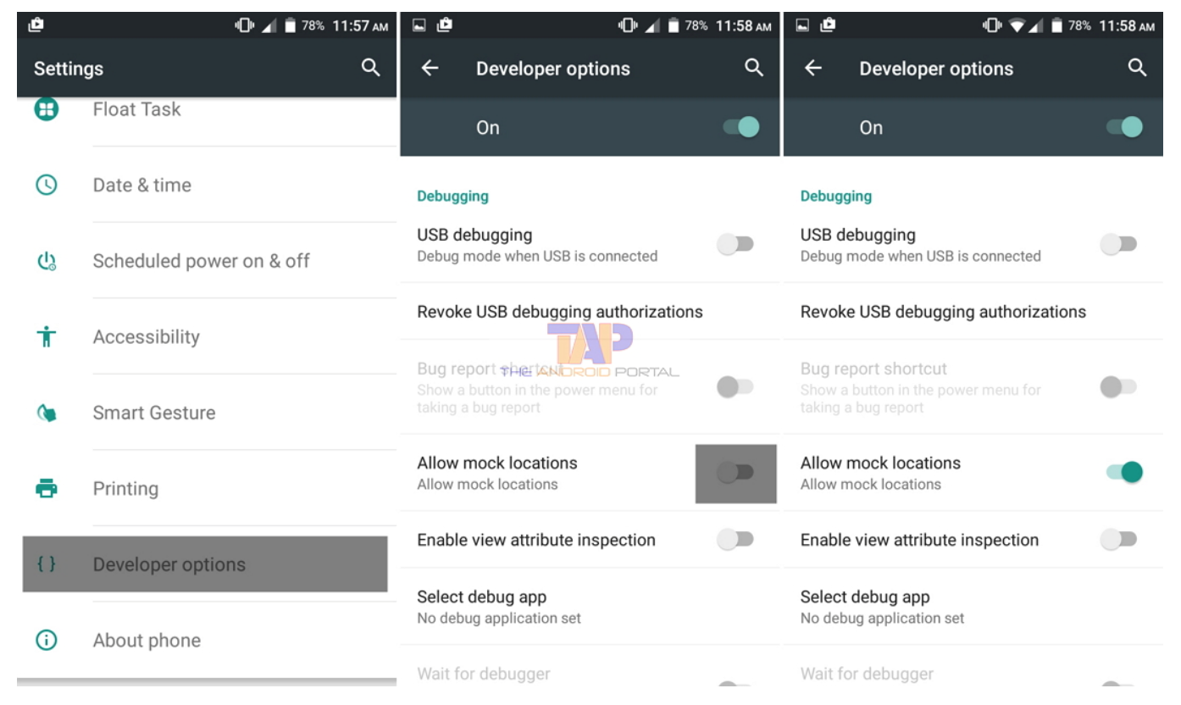
How to activate mock locations on Android
1. First, open the "Setting" application on your phone
2. Scroll down and select "Developer Options" and open it.
3. In Developer Options, scroll down and look for the option "Allow simulated location"
4. Here you can activate and deactivate the simulated location using the "Slider" button or assign a simulated location to a given application.
Bonus: There are several applications (like Lefebure Ntrip Client) that can do the work for you because when assigned, all other applications will benefit from the "pipe".

Slide 20
By activating "mock location" for a given application, it will take data from an external GNSS receiver (via Bluetooth) configured to send NMEA frames
All applications using your position and configured with the "internal receiver" will benefit from the positions of the "external" receiver instead of the integrated chipset
Simply said : "mock location" replaces the internal GPS / GNSS receiver with the data of the application indicated in "mock location".

Slide 21
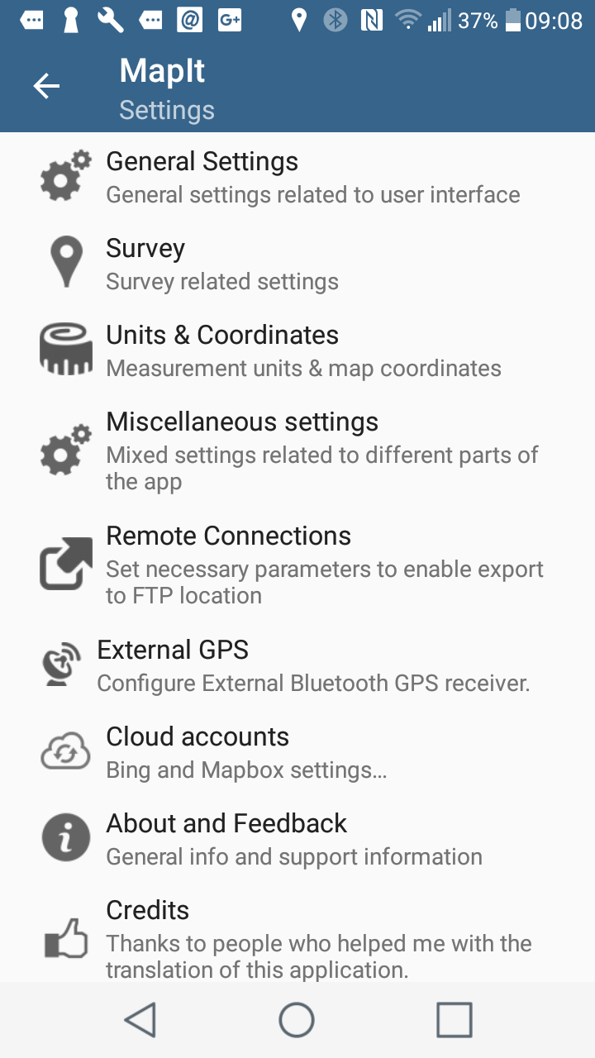
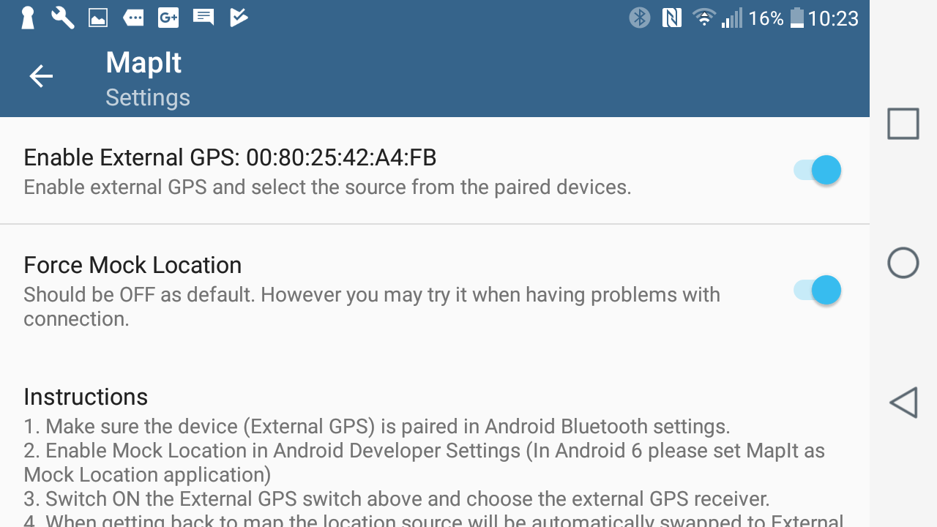
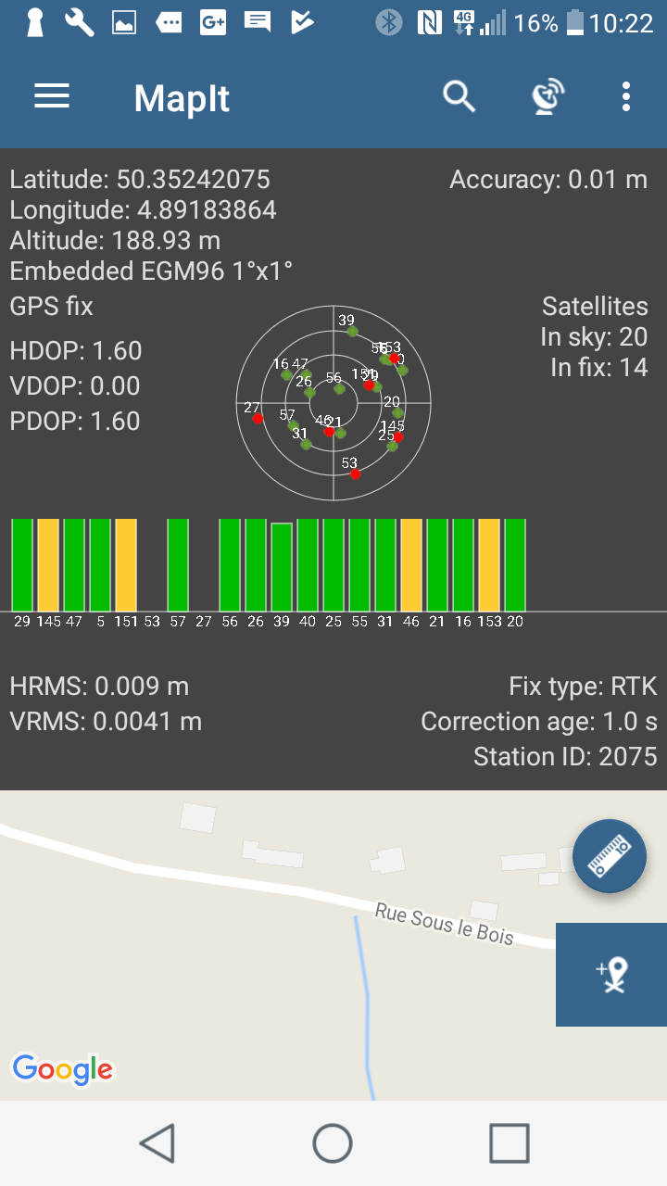
To use MapIt ... first make sure that the G100 / G200 is paired with Bluetooth (the pairing code is "0000" so 4 x zero!
Then activate "External GPS" ... "Force Mock Location" and then MapIt will pair you with the G100 / G200 in select mode (GNSS single, EGNOS) but not in RTK mode! Note that all other applications will benefit from the positions that MapIt receives because MapIt will act as a "server" position instead of the internal GPS / GNSS chipset.

Slide 22
G100 + EGNOS + MapIt
You want to configure your G100 in EGNOS and paired with MapIt application ?
Connect the G100 with a PC, by cable RS-232 or Bluetooth
Use CRU.EXE for sending the following commands:
LOG COM3 GPGGA ONTIME 1 … COM3 is the BT port for the G100/G200
LOG COM3 GPRMC ONTIME 1
SBASCONTROL ENABLE EGNOS
RTKOBSMODE 3
SAVECONFIG
Quit CRU.EXE (Close), configure your Smartphone (developper mode/Mock Location) and configure MapIt … to use your G100 assigned by BT !

Slide 23
Conclusion
The agility of the G100 / G200 makes it possible to implement it in a multitude of applications and place it at the heart of a sophisticated measurement system ... And of course to use it in surveying tasks !
We have presented some of the possibilities to configure the G100 / G200 and we are at your disposal to explore these and other news.
Join us by adopting also the G100 / G200!

